Slide 1
Trophic Structure

Slide 2
Trophic Structure
0
Trophic structure
A pattern of feeding relationships consisting of several different levels
Food chain
Sequence of food transfer up the trophic levels
Notes:
Student Misconceptions and Concerns
1. For many students, understanding ecosystems is like appreciating art. Although both are visible to the naked eye, in each case some background is required to understand the method of composition, the significance of components, and the nature of interactions. The fundamentals introduced in this chapter are new ways to see generally familiar systems.
Teaching Tips
1. Many students have been exposed to diverse ecosystems only through television and movies, which have likely focused on a few species. Before discussing this chapter, consider showing the class a good video (it need not be long) about an ecosystem. The video can then serve as a shared recent experience to which you can relate the content of this chapter. Alternately, you can relate some of the basics of this chapter to a local or regional example with which most students are familiar. There may even be a distinct community on your campus, such as a pond, wooded area, etc., that students could visit and return from with new insights.
2. Students have often had prior exposure to the concepts of food webs and food chains. Present a food web (perhaps Figure 37.9) to your class and challenge them to predict the consequences of a decrease or increase in the population of one of the organisms. This activity can help students understand how difficult it is to make precise predictions about these complex systems.

Slide 3
Trophic Structure
0
Producers
Support all other trophic levels
Autotrophs
Photosynthetic producers
Plants on land
Cyanobacteria in water
Notes:
Student Misconceptions and Concerns
1. For many students, understanding ecosystems is like appreciating art. Although both are visible to the naked eye, in each case some background is required to understand the method of composition, the significance of components, and the nature of interactions. The fundamentals introduced in this chapter are new ways to see generally familiar systems.
Teaching Tips
1. Many students have been exposed to diverse ecosystems only through television and movies, which have likely focused on a few species. Before discussing this chapter, consider showing the class a good video (it need not be long) about an ecosystem. The video can then serve as a shared recent experience to which you can relate the content of this chapter. Alternately, you can relate some of the basics of this chapter to a local or regional example with which most students are familiar. There may even be a distinct community on your campus, such as a pond, wooded area, etc., that students could visit and return from with new insights.
2. Students have often had prior exposure to the concepts of food webs and food chains. Present a food web (perhaps Figure 37.9) to your class and challenge them to predict the consequences of a decrease or increase in the population of one of the organisms. This activity can help students understand how difficult it is to make precise predictions about these complex systems.

Slide 4
Trophic Structure
0
Consumers
Heterotrophs
Primary consumers
Secondary consumers
Tertiary consumers
Quaternary consumers
Detritivores and decomposers
Derive energy from dead matter and wastes
Notes:
Student Misconceptions and Concerns
1. For many students, understanding ecosystems is like appreciating art. Although both are visible to the naked eye, in each case some background is required to understand the method of composition, the significance of components, and the nature of interactions. The fundamentals introduced in this chapter are new ways to see generally familiar systems.
Teaching Tips
1. Many students have been exposed to diverse ecosystems only through television and movies, which have likely focused on a few species. Before discussing this chapter, consider showing the class a good video (it need not be long) about an ecosystem. The video can then serve as a shared recent experience to which you can relate the content of this chapter. Alternately, you can relate some of the basics of this chapter to a local or regional example with which most students are familiar. There may even be a distinct community on your campus, such as a pond, wooded area, etc., that students could visit and return from with new insights.
2. Students have often had prior exposure to the concepts of food webs and food chains. Present a food web (perhaps Figure 37.9) to your class and challenge them to predict the consequences of a decrease or increase in the population of one of the organisms. This activity can help students understand how difficult it is to make precise predictions about these complex systems.

Slide 5
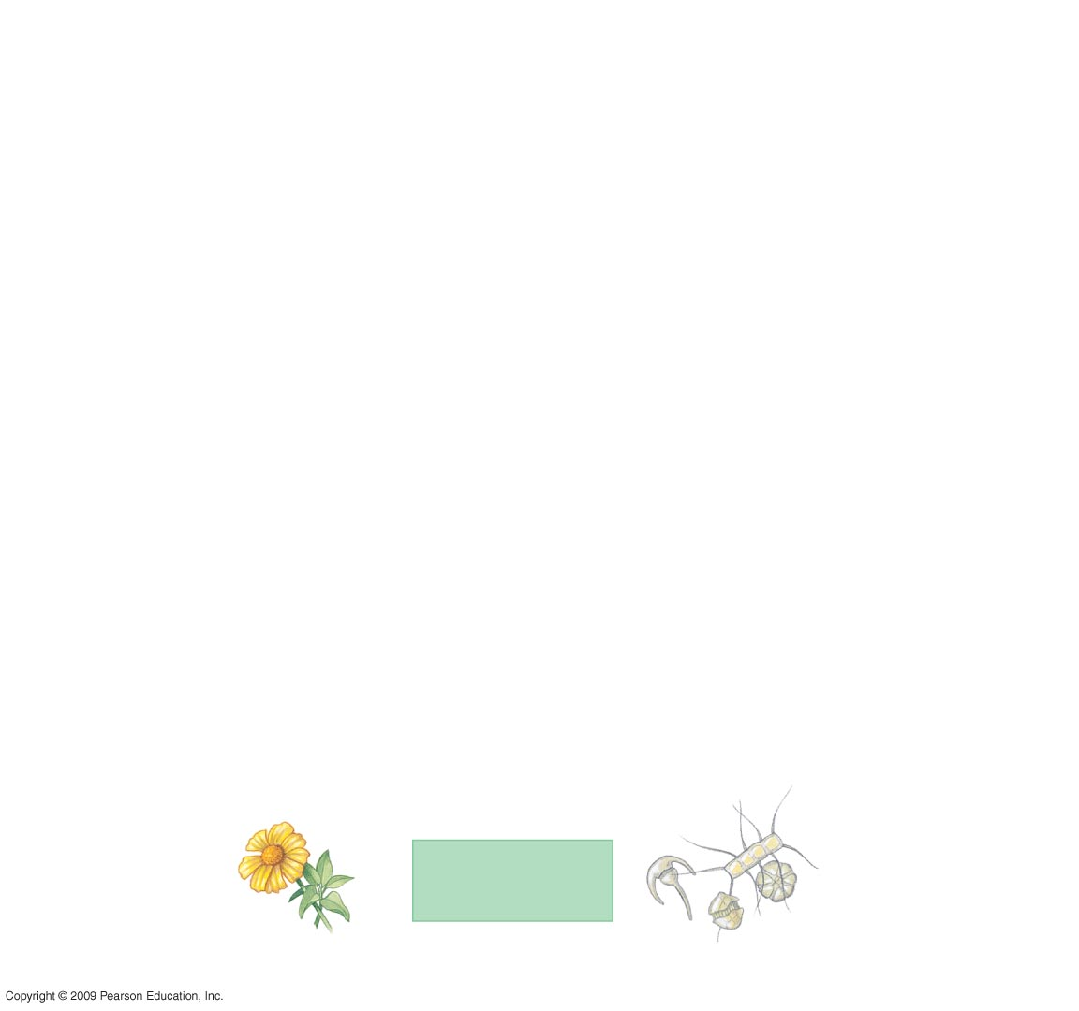
Plant
Producers
Phytoplankton
A terrestrial food chain
An aquatic food chain
Notes:
Figure 37.8 Two food chains.

Slide 6
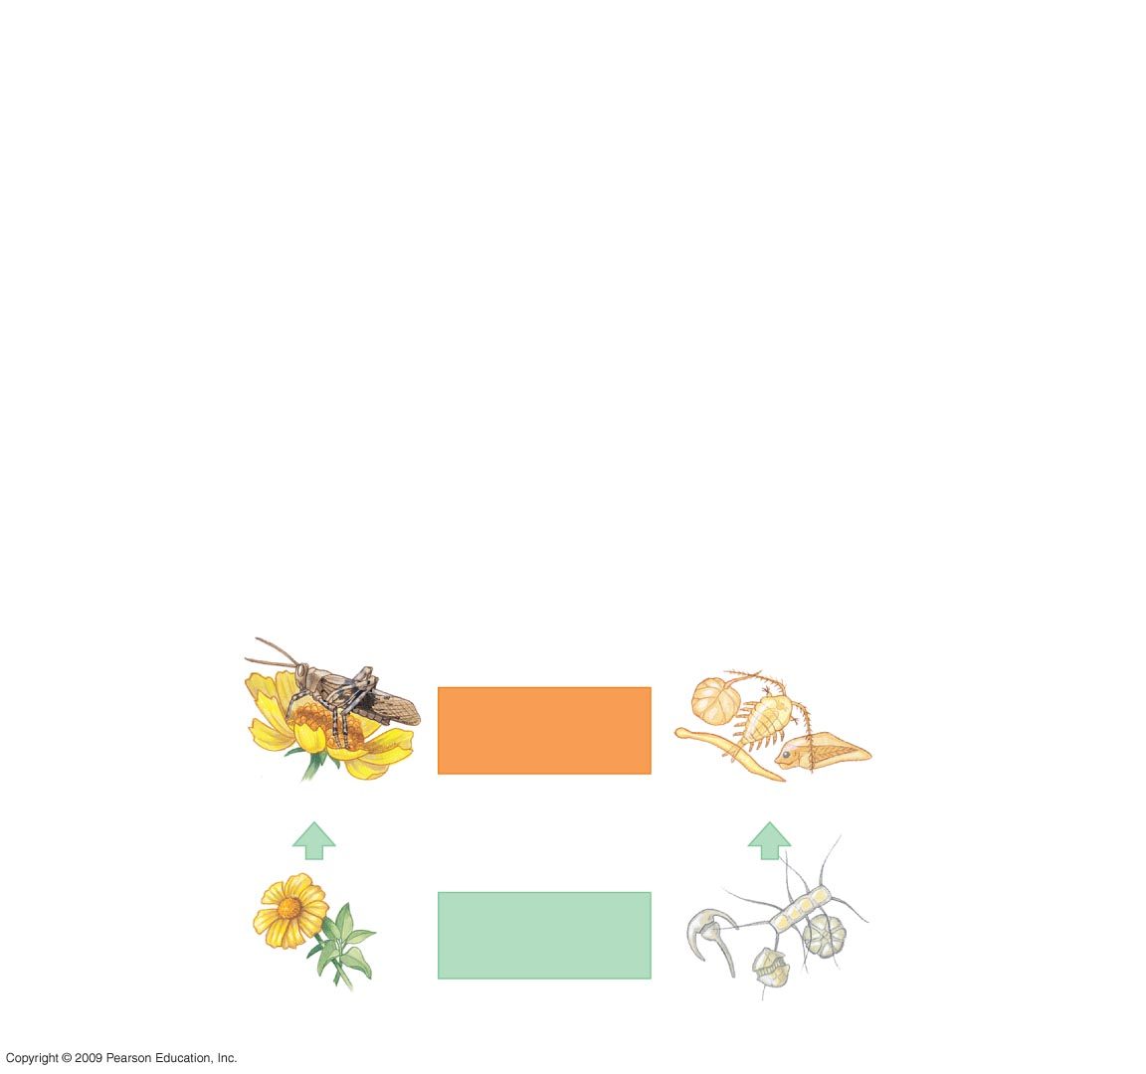
Grasshopper
Primary
consumers
Zooplankton
Plant
Producers
Phytoplankton
A terrestrial food chain
An aquatic food chain
Notes:
Figure 37.8 Two food chains.

Slide 7
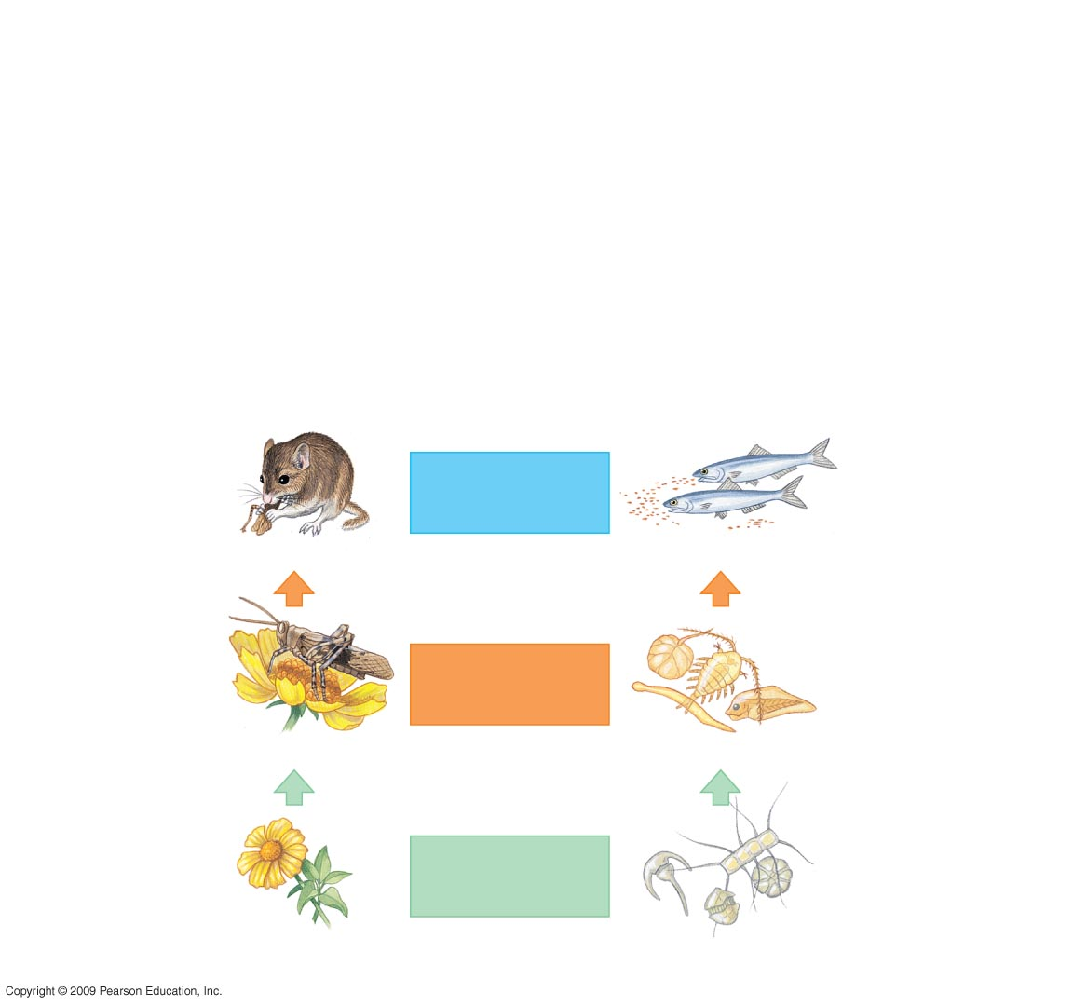
Mouse
Secondary
consumers
Herring
Grasshopper
Primary
consumers
Zooplankton
Plant
Producers
Phytoplankton
A terrestrial food chain
An aquatic food chain
Notes:
Figure 37.8 Two food chains.

Slide 8
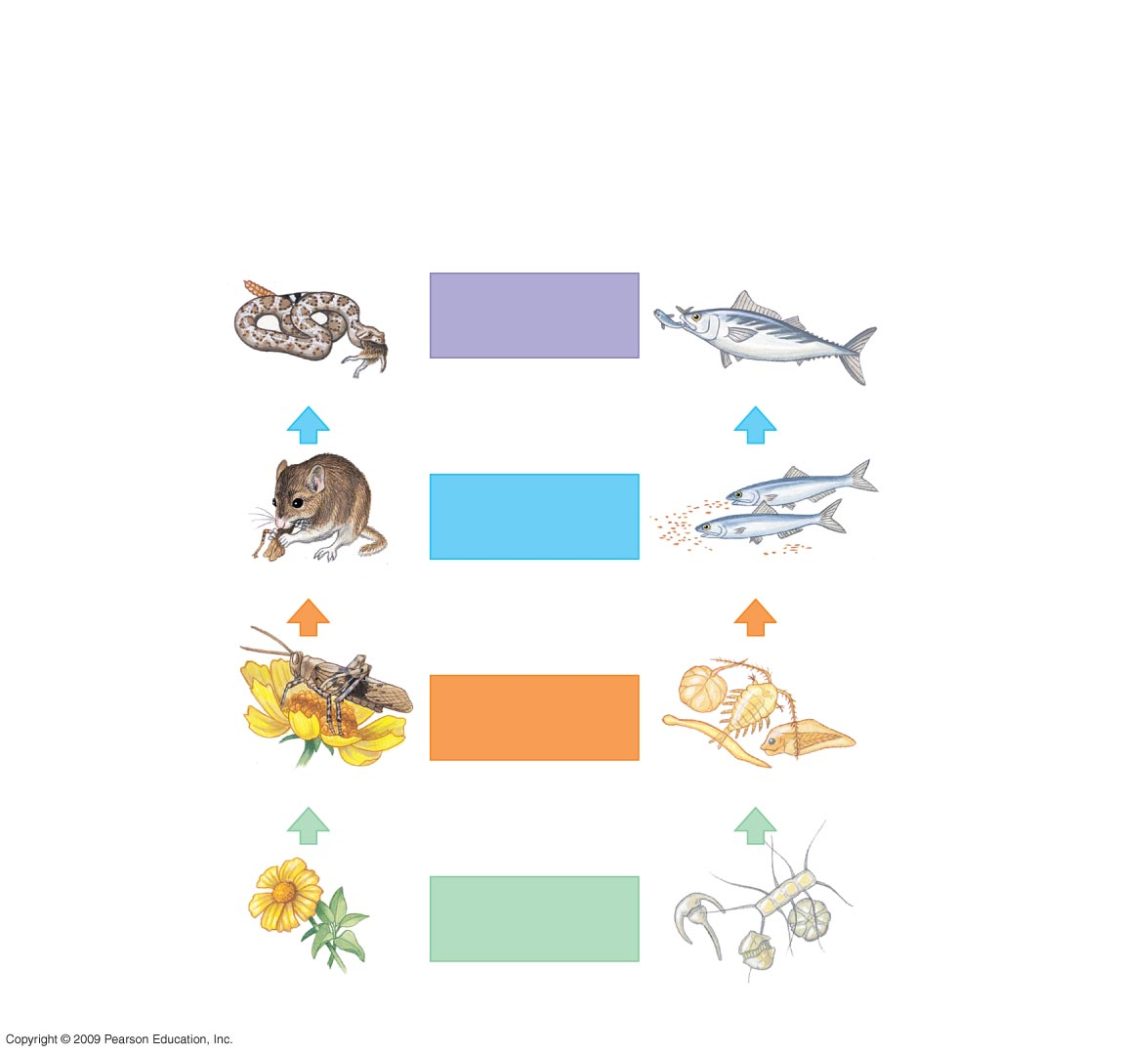
Snake
Tertiary
consumers
Tuna
Mouse
Secondary
consumers
Herring
Grasshopper
Primary
consumers
Zooplankton
Plant
Producers
Phytoplankton
A terrestrial food chain
An aquatic food chain
Notes:
Figure 37.8 Two food chains.

Slide 9
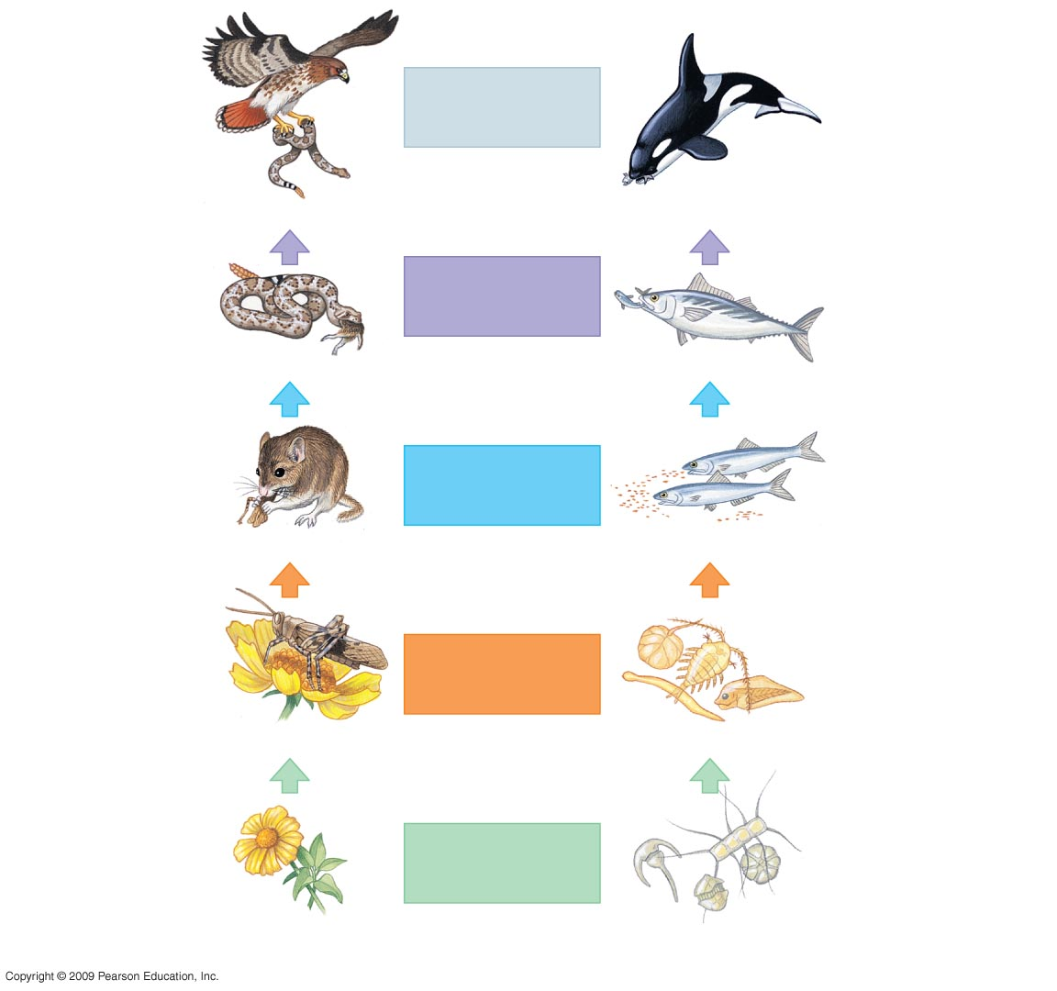
Trophic level
Quaternary
consumers
Hawk
Killer whale
Snake
Tertiary
consumers
Tuna
Mouse
Secondary
consumers
Herring
Grasshopper
Primary
consumers
Zooplankton
Plant
Producers
Phytoplankton
A terrestrial food chain
An aquatic food chain
Notes:
Figure 37.8 Two food chains.

Slide 10
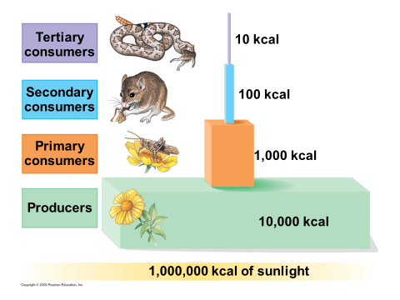
Energy and Food Chains
Energy is lost as it is transferred up the food chain
80-95% of energy is lost!!

Slide 11
Food Chains Form Food Webs
0
Food web
A network of interconnecting food chains
Notes:
Student Misconceptions and Concerns
1. For many students, understanding ecosystems is like appreciating art. Although both are visible to the naked eye, in each case some background is required to understand the method of composition, the significance of components, and the nature of interactions. The fundamentals introduced in this chapter are new ways to see generally familiar systems.
Teaching Tips
1. Many students have been exposed to diverse ecosystems only through television and movies, which have likely focused on a few species. Before discussing this chapter, consider showing the class a good video (it need not be long) about an ecosystem. The video can then serve as a shared recent experience to which you can relate the content of this chapter. Alternately, you can relate some of the basics of this chapter to a local or regional example with which most students are familiar. There may even be a distinct community on your campus, such as a pond, wooded area, etc., that students could visit and return from with new insights.
2. Students have often had prior exposure to the concepts of food webs and food chains. Present a food web (perhaps Figure 37.9) to your class and challenge them to predict the consequences of a decrease or increase in the population of one of the organisms. This activity can help students understand how difficult it is to make precise predictions about these complex systems.

Slide 12
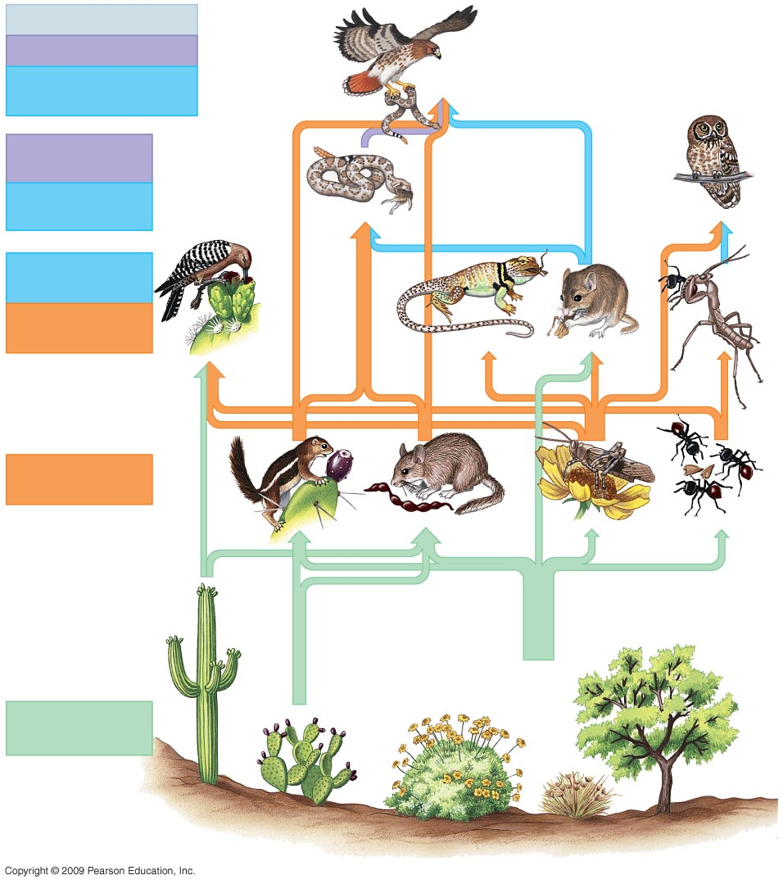
Quaternary,
tertiary,
and secondary
consumers
Tertiary
and
secondary
consumers
Secondary
and
primary
consumers
Primary
consumers
Producers
(plants)
Notes:
Figure 37.9 A food web.

Slide 13
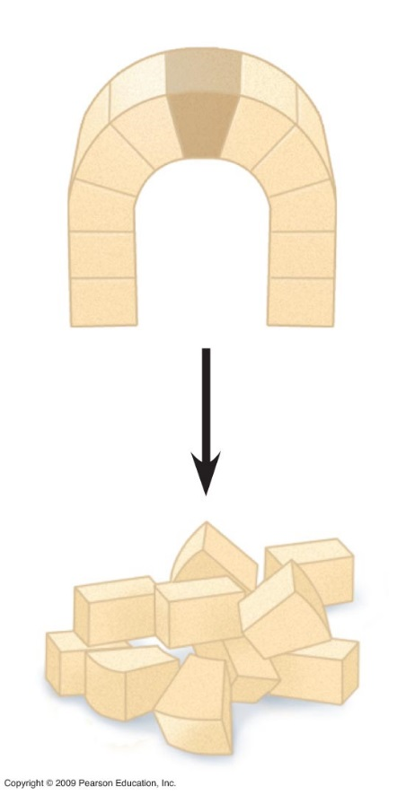
Keystone species have a disproportionate impact on diversity
0
Keystone species
A species whose impact on its community is larger than its biomass or abundance indicates
Occupies a niche that holds the rest of its community in place
Keystone
Keystone
absent
Notes:
Student Misconceptions and Concerns
1. For many students, understanding ecosystems is like appreciating art. Although both are visible to the naked eye, in each case some background is required to understand the method of composition, the significance of components, and the nature of interactions. The fundamentals introduced in this chapter are new ways to see generally familiar systems.
Teaching Tips
1. Many students have been exposed to diverse ecosystems only through television and movies, which have likely focused on a few species. Before discussing this chapter, consider showing the class a good video (it need not be long) about an ecosystem. The video can then serve as a shared recent experience to which you can relate the content of this chapter. Alternately, you can relate some of the basics of this chapter to a local or regional example with which most students are familiar. There may even be a distinct community on your campus, such as a pond, wooded area, etc., that students could visit and return from with new insights.
2. Many keystone species have been identified in ecosystems, including sea otters, elephants, freshwater bass, and Pisaster, a sea star noted in Figure 37.11. Challenge your class to explain how the concept of keystone species impacts the efforts of conservation biologists. Why might some species be more important to conserve?

