Slide 1
Speciation
Making a species through evolution

Slide 2
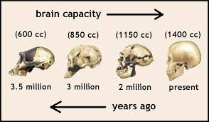
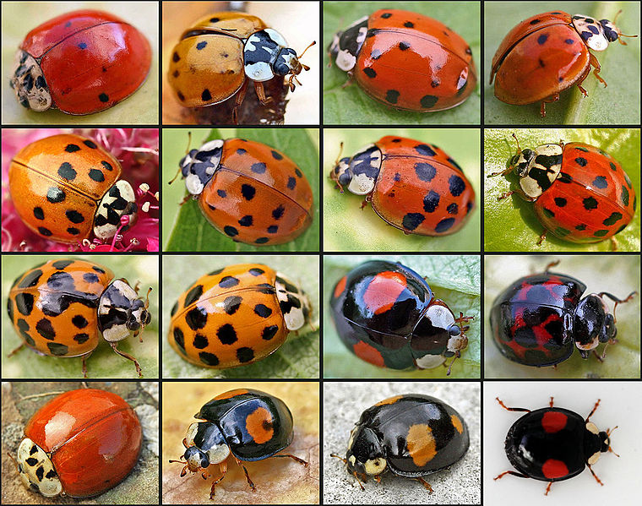
What defines a species?
Species: a group of organisms that can interbreed and produce fertile offspring
“Biological Species Concept”
Human species?
Homo sapiens – “wise man” (large brains!)
Do species always look different?
No! Genetics not always “visible”.

Slide 3
How are species created?
Reproductive Isolation: when 2 organisms can no longer reproduce fertile offspring
Speciation has occurred
Pre zygotic isolation: fertilization never occurs
Behavioral changes—birds sing different song
Location changes—birds living in different types of trees
Post zygotic isolation: unfertile or non vital offspring
Mules
Ligers, zebroids, etc.

Slide 4
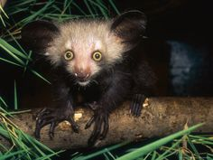
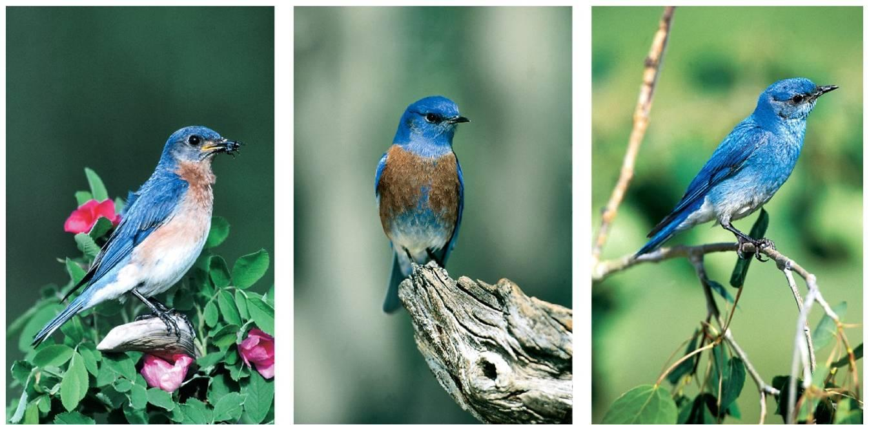
Prezygotic Isolation
Fertilization is unable to occur
Habitat: no opportunity to come in contact
Temporal: different breeding seasons/times
Behavioral: send or receives different courtship signals
Mechanical: physical incompatibility
Gametic: incompatible on molecular level in sperm/egg/pollen

Slide 5
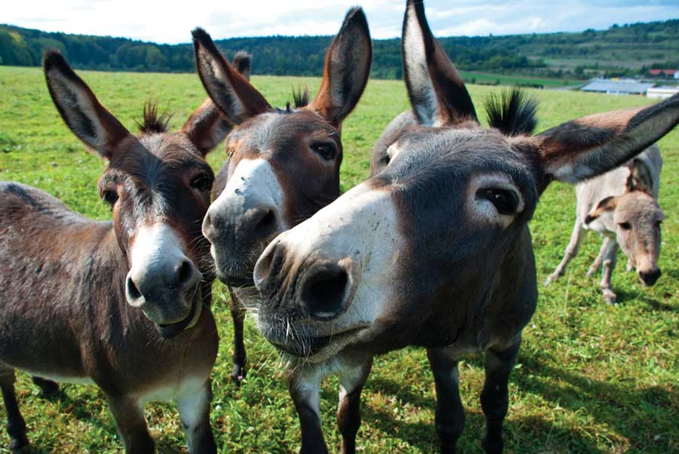
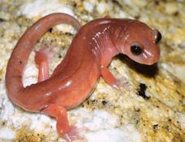
Postzygotic Isolation
Fertilization is able to take place, but produces unviable or sterile hybrid offspring
Reduced hybrid viability: offspring do not develop fully or are weak and have short lifespan
Reduced hybrid fertility: offspring is strong and healthy, but sterile and unable to produce offspring

Slide 6
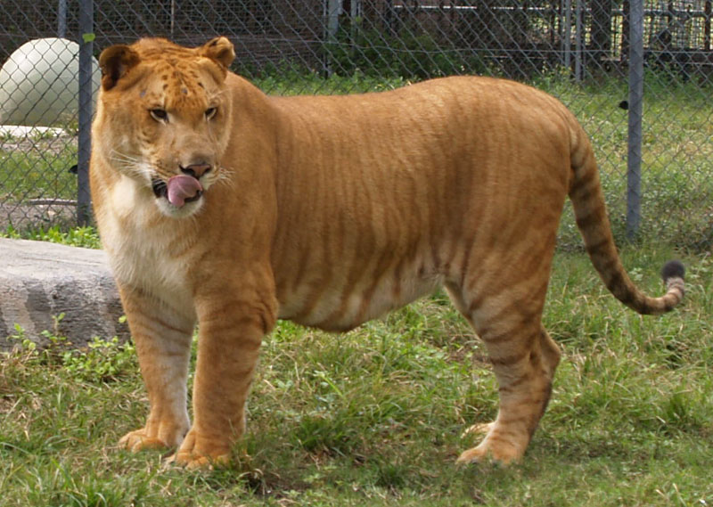
Hybrids
Species: a group of organisms that can interbreed and reproduce fertile offspring
Tiger and Lion??
Liger! ….No baby Ligers.
Hybrid: sterile offspring of 2 different species

Slide 7
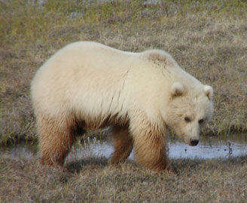
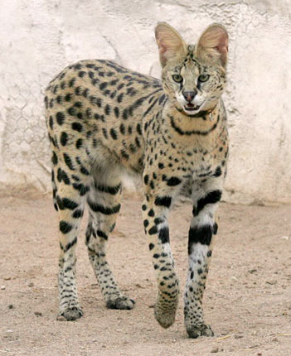
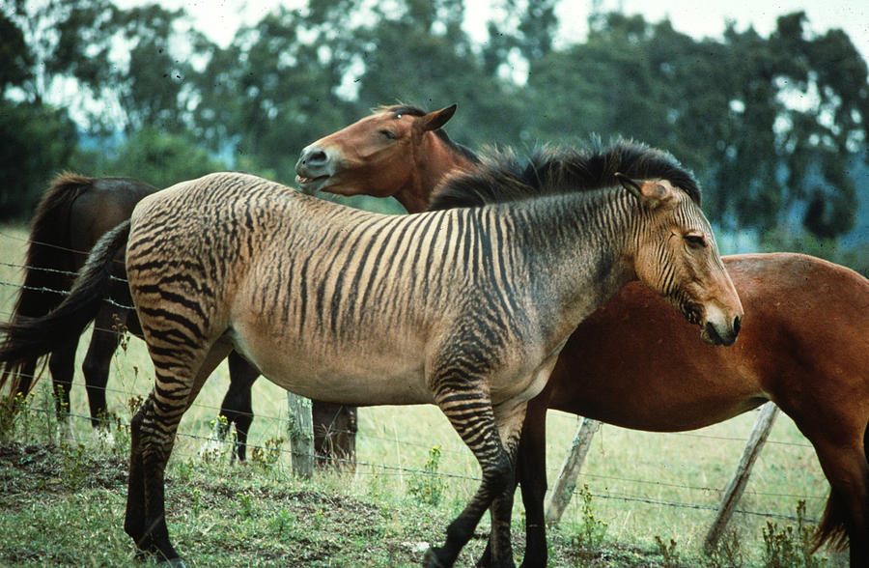
Hybrids
Grizzly Bear and Polar Bear
Grolar Bear
Increasing?
Zebra and Horse
Zebroid
House Cat and Wild African Cat
Savannah Cat

Slide 8
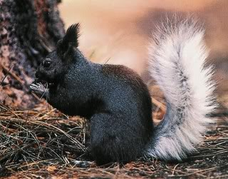
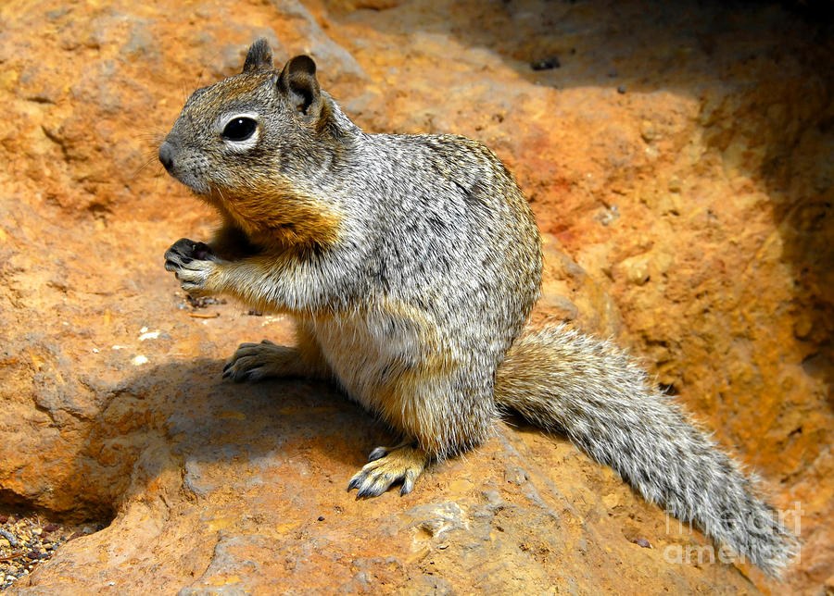
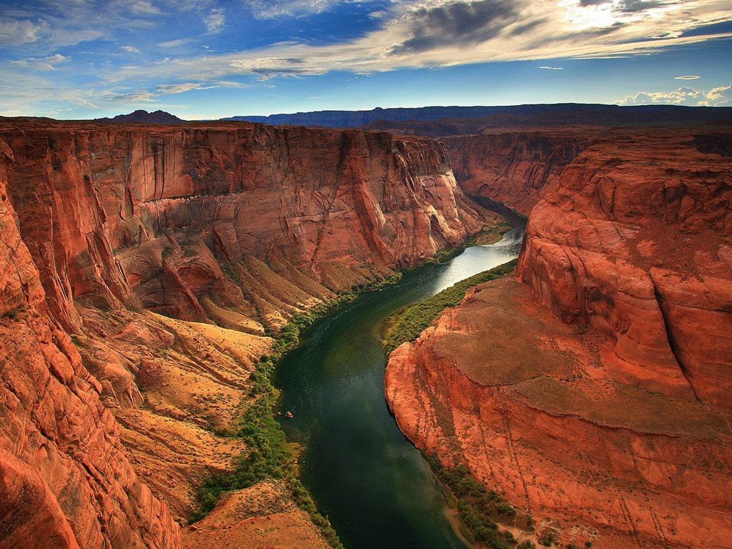
Types of Speciation
Allopatric Speciation: occurs when a population becomes separated by a geographic barrier (mountain, river, etc.)
Isolated into different environments
Different environmental pressures
Different alleles are selected through natural selection
Example: Squirrels in Arizona & Grand Canyon

Slide 9
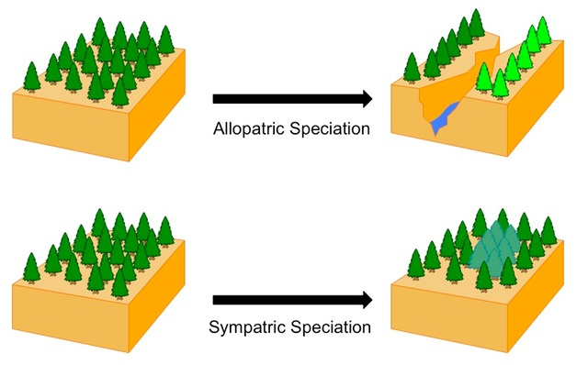
Types of Speciation
Sympatric Speciation: species created without a geographic barrier
Less common
Most often takes place in plant species

