Slide 1
Evolution: Types of Natural Selection

Slide 2
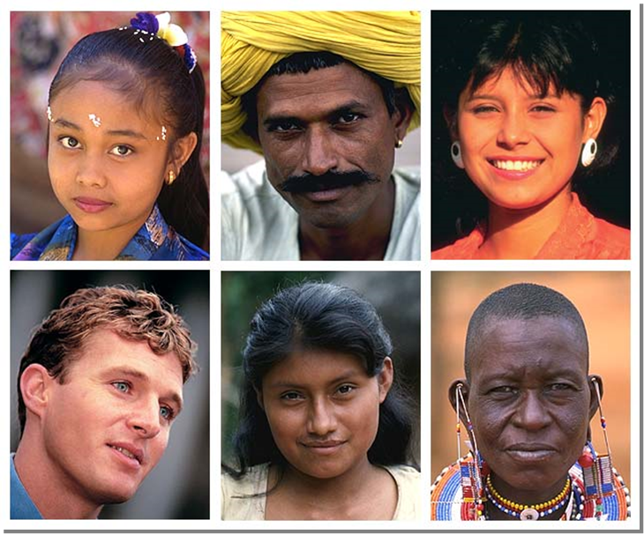
Natural Selection: What We Know
Populations are a mix of different individuals
Genetic Variation
Those individuals over reproduce
Creating competition
Not everyone survives
Those best suited for their environment pass on their unique genes (traits) to their offspring
Those genes increase in the population

Slide 3
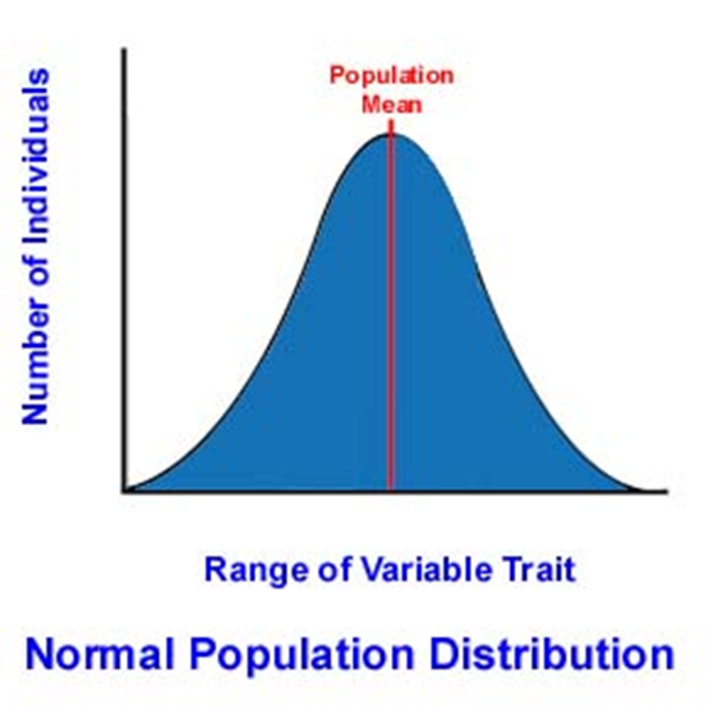
Types of Selection
Directional Selection: favors extremes
Stabilizing Selection: favors the middle
Disruptive Selection: nature favors extremes and middle is selected against
Sexual Selection: increasing probability of reproducing
Artificial Selection: humans get involved!

Slide 4
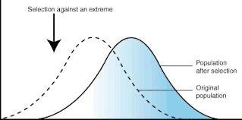
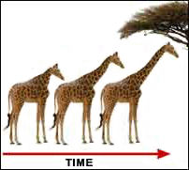
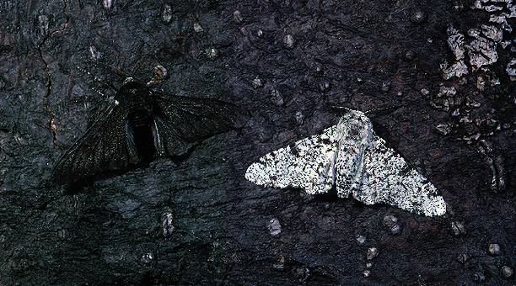
Directional Selection
Directional Selection: favors trait at one extreme
Often happens when environment changes in a consistent way
(ex: gets colder)
Peppered Moth
Giraffe neck

Slide 5
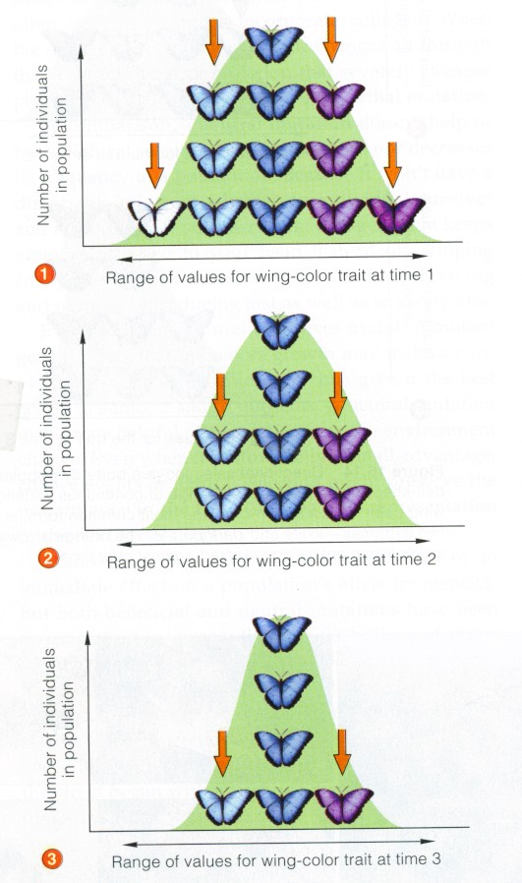
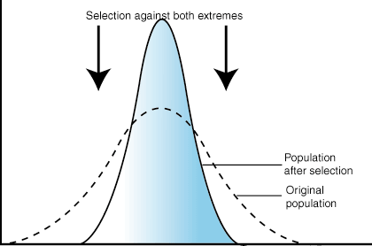
Stabilizing Selection
Selects against the extremes—middle is best
Optimizes for environment
Example: camouflage, human birth weight

Slide 6
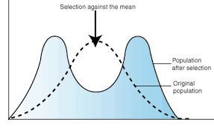
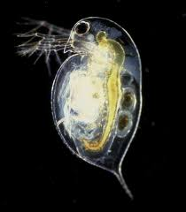
Disruptive Selection
Nature favors the extremes
Middle is selected against
Example: Daphnia and yeast infection
Smaller daphnia are less susceptible to infection but produce less offspring
Larger daphnia are more susceptible to infection but produce more offspring while alive

Slide 7
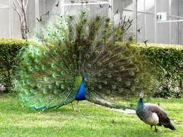
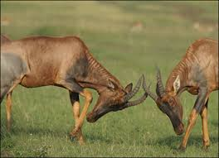
Sexual Selection
Increases probability of reproducing
Competition for passing on genes!
Examples: male peacock feathers (attracting opposite sex) or intimidation of other males (eliminate same sex)

Slide 8
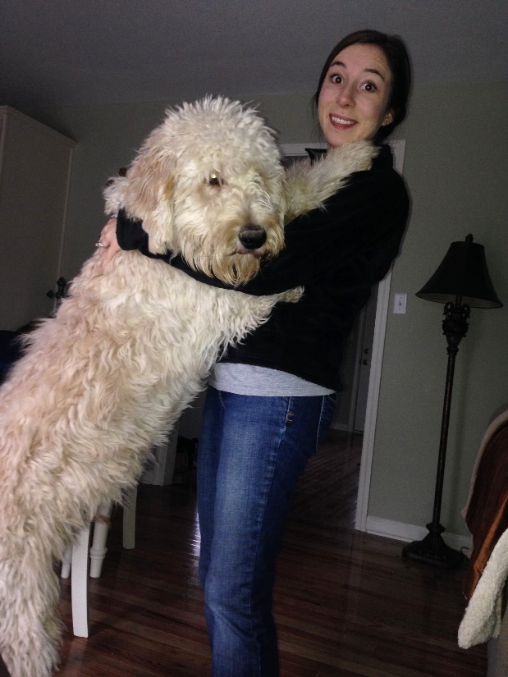
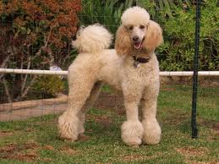
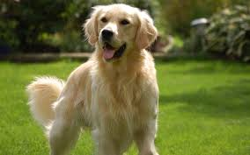
Artificial Selection
Humans involved in breeding
Nature no longer doing the selecting
Examples: dog breeds, agricultural crops

Slide 9
Birth Weights
1-1.5: 2%
1.5-2: 6%
2-2.5: 6%
2.5-3: 13%
3-3.5: 35%
3.5-4: 32%
4-4.5: 15%
4.5-5: 4%

