Slide 1
Population Genetics
Darwin meets Mendel

Slide 2
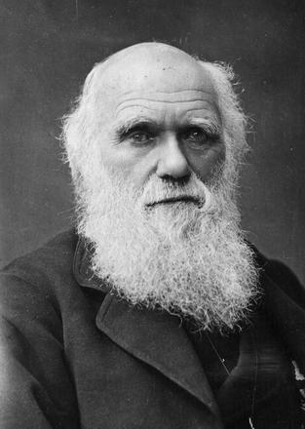
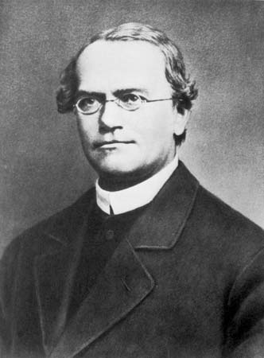
Population Genetics
Charles Darwin meets Gregor Mendel
Who is Mendel again…?
Genetics of population of species change over time—population evolves
Population: group of individuals within a species that can interbreed

Slide 3
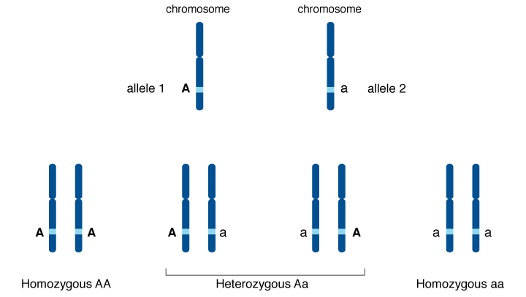
Population Genetics: Alleles
Tracking changes in allele frequency
What is an allele again….?

Slide 4
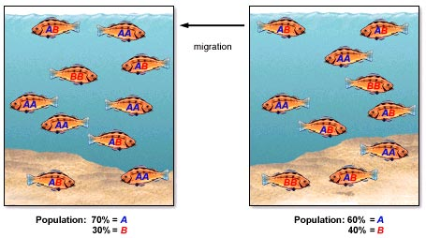
Population Genetics: Alleles
Allele frequency: how often certain alleles (A, a) show up in a population
Changes in allele frequency is how evolution takes place!

Slide 5
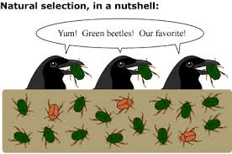
What changes allele frequency?
1. Natural Selection: more fit alleles are selected for by the environment
More fit not best fit
Survival and reproduction of the fittest from what is currently available

Slide 6
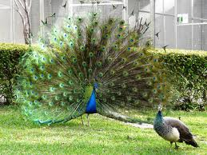
What changes allele frequency?
2. Sexual Selection: trait that causes an individual to reproduce more than others
Mating is not random! Females are choosy!
Result: passes on those alleles to offspring and increases that allele frequency in the population
Very important in populations

Slide 7
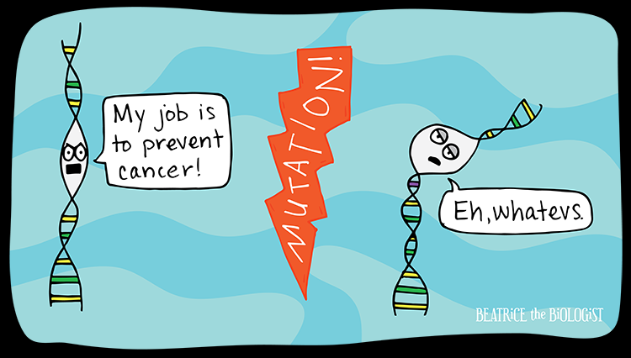
What changes allele frequency?
3. Mutations: mistakes in the copying process during mitosis
Completely random!!
Most are harmful!
Beneficial mutations will be selected for by the environment
Those beneficial alleles will increase in frequency in the population

Slide 8
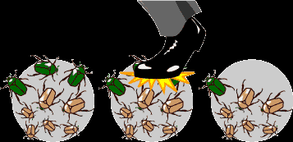
What changes allele frequency?
4. Genetic Drift: changes in allele frequency due to random chance
Example: bug is stepped on, flood takes out random group, deer hit by car
Greater effect in smaller populations

Slide 9
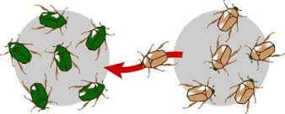
What changes allele frequency?
5. Gene Flow: new individuals enter the population
New alleles are now in the population
Greater effects on smaller populations

Slide 10
Can allele frequency be measured?
Yes!—if you ignore everything I just told you. Population is NOT evolving
NOT ALLOWED:
Natural Selection—all alleles are equally fit
Sexual Selection—mating is completely random!
Mutations—all alleles are unchanged
Genetic drift—very very large population sizes
Gene flow—no strangers allowed.
IF the above is true, allele frequency can be measured using the Hardy-Weinburg Equilibrium equation

Slide 11
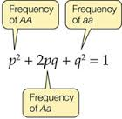
Hardy Weinburg Equilibrium
These conditions can only occur in the minds of biologist—not nature.
How is this even useful?
A standard to compare against evolving populations
Helps doctors predict carriers of diseases

Slide 12
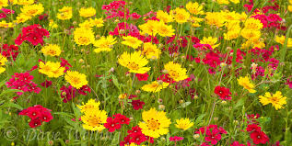
Hardy-Weinberg Scenarios
The following are scenarios based off a wildflower population. For each of the scenarios:
1. State why it does not meet the conditions required of the Hardy-Weinberg Equilibrium
2. Is natural selection and adaptation taking place? Why or why not?

Slide 13
Hardy-Weinberg Scenarios
1. A windstorm blows in hundreds of seeds from a nearby meadow, where nearly all the flowers are yellow.

Slide 14
Hardy-Weinberg Scenarios
2. A pollutant molecule from the soil gets in the way just as a developing egg cell in one of the red flowers is replicating its DNA. By chance, a red allele is transformed into a yellow allele.

Slide 15
Hardy-Weinberg Scenarios
3. The flowers tend to grow in red or yellow patches. A landslide buries and kills most of the red flowers.

Slide 16
Hardy-Weinberg Scenarios
4. The red pigment in the petals of the red flowers is poisonous and protects them from beetles that eat the developing seeds. The yellow flowers are not protected in this way.

Slide 17
Hardy-Weinberg Scenarios
5. The bees that pollinate the flowers tend to develop a “search image”. Once they start visiting flowers of a certain color, they stick to that color. So pollen from red flowers is more likely to be delivered to other red flowers, and pollen from yellow flowers is more likely to fertilize other yellow flowers.

