Slide 1
Population Ecology
0
Population ecology is concerned with
Changes in population size
Factors that regulate populations over time
It helps explain the biodiversity of an environment
Copyright © 2009 Pearson Education, Inc.

Slide 2
Population Ecology
0
Ecologists learn the structure and dynamics of natural populations
With this information they are better equipped to
Develop sustainable food sources
Assess the impact of human activities
Balance human needs with the conservation of biodiversity and resources
Copyright © 2009 Pearson Education, Inc.

Slide 3
Population Ecology : how and why populations change
0
Population
A group of individuals of a single species that occupy the same general area
Individuals in a population
Rely on the same resources
Are influenced by the same environmental factors
Are likely to interact and breed with one another
Copyright © 2009 Pearson Education, Inc.
Notes:
Student Misconceptions and Concerns
1. Many students who are not biology majors have trouble thinking about the evolution of systems. One analogy that can be developed, especially for economically-minded students, is the parallels to the “evolution” of businesses. Consider the introduction and expansion of McDonald’s restaurants in the United States over the last 50 years. When McDonald’s restaurants were just starting out, they experienced little competition, with access to many customers. The “population” of McDonald’s restaurants in the United States grew exponentially (or nearly so), with few density dependent factors. However, today McDonald’s restaurants in the U.S. must compete with each other, as well as with many other fast-food restaurants, such as Burger King and Taco Bell. The population of McDonald’s restaurants in the United States has stabilized because of this competition for customers, a density dependent factor. A graph of the growth of McDonald’s restaurants in the United States would likely resemble the lazy “S” shape.
Teaching Tips
1. Use of the mark-recapture method to estimate the size of a population is discussed in the Applying the Concepts section at the end of Chapter 36. The following can serve as a demonstration of the mark-recapture method or an activity for students working in small groups:
a) Provide each group with an opaque bag (brown paper lunch bags work well) of about 200 dried lima beans (or any inexpensive small item that can be marked).
b) Have each group draw out 40 beans.
c) Mark each bean with a distinct pencil or ink mark.
d) Return these marked beans back to the bag.
e) Mix the beans in the bag by shaking or turning the bag. Note: Thorough mixing and random selection is essential to the mark-recapture method. You may wish to note here that this research method does not work well for wildlife populations that are territorial and thus do not mix.
f) Draw out another 40 beans, and count the number of marked beans in the sample.
g) The formula for calculating the population size is as follows: The number of marked beans in the first sample × the total number in the second sample ÷ the number of recaptures in the second sample = the population size. Thus, if you started out with exactly 200 beans, sampled 40, marked them, and resampled 40 beans, we would expect that you would recapture 8 marked beans, based on the equation 40 × 40 ÷ 8 = 200.

Slide 4
Population Ecology: how and why populations change
0
A population can be described by the number and distribution of individuals
Population dynamics is the interactions between
Biotic and abiotic factors
It is the cause of variation in population sizes
A population increases through birth and immigration
Death and emigration out of an area decrease the population
Copyright © 2009 Pearson Education, Inc.
Notes:
Student Misconceptions and Concerns
1. Many students who are not biology majors have trouble thinking about the evolution of systems. One analogy that can be developed, especially for economically-minded students, is the parallels to the “evolution” of businesses. Consider the introduction and expansion of McDonald’s restaurants in the United States over the last 50 years. When McDonald’s restaurants were just starting out, they experienced little competition, with access to many customers. The “population” of McDonald’s restaurants in the United States grew exponentially (or nearly so), with few density dependent factors. However, today McDonald’s restaurants in the U.S. must compete with each other, as well as with many other fast-food restaurants, such as Burger King and Taco Bell. The population of McDonald’s restaurants in the United States has stabilized because of this competition for customers, a density dependent factor. A graph of the growth of McDonald’s restaurants in the United States would likely resemble the lazy “S” shape.
Teaching Tips
1. Use of the mark-recapture method to estimate the size of a population is discussed in the Applying the Concepts section at the end of Chapter 36. The following can serve as a demonstration of the mark-recapture method or an activity for students working in small groups:
a) Provide each group with an opaque bag (brown paper lunch bags work well) of about 200 dried lima beans (or any inexpensive small item that can be marked).
b) Have each group draw out 40 beans.
c) Mark each bean with a distinct pencil or ink mark.
d) Return these marked beans back to the bag.
e) Mix the beans in the bag by shaking or turning the bag. Note: Thorough mixing and random selection is essential to the mark-recapture method. You may wish to note here that this research method does not work well for wildlife populations that are territorial and thus do not mix.
f) Draw out another 40 beans, and count the number of marked beans in the sample.
g) The formula for calculating the population size is as follows: The number of marked beans in the first sample × the total number in the second sample ÷ the number of recaptures in the second sample = the population size. Thus, if you started out with exactly 200 beans, sampled 40, marked them, and resampled 40 beans, we would expect that you would recapture 8 marked beans, based on the equation 40 × 40 ÷ 8 = 200.

Slide 5
Density and Dispersion Patterns
0
Population density is the number of individuals of a species per unit area or volume
Examples of population density
The number of oak trees per square kilometer in a forest
The number of earthworms per cubic meter in forest soil
Ecologists use a variety of sampling techniques to estimate population densities
Copyright © 2009 Pearson Education, Inc.
Notes:
Student Misconceptions and Concerns
1. Many students who are not biology majors have trouble thinking about the evolution of systems. One analogy that can be developed, especially for economically-minded students, is the parallels to the “evolution” of businesses. Consider the introduction and expansion of McDonald’s restaurants in the United States over the last 50 years. When McDonald’s restaurants were just starting out, they experienced little competition, with access to many customers. The “population” of McDonald’s restaurants in the United States grew exponentially (or nearly so), with few density dependent factors. However, today McDonald’s restaurants in the U.S. must compete with each other, as well as with many other fast-food restaurants, such as Burger King and Taco Bell. The population of McDonald’s restaurants in the United States has stabilized because of this competition for customers, a density dependent factor. A graph of the growth of McDonald’s restaurants in the United States would likely resemble the lazy “S” shape.
Teaching Tips
1. A simple application of the dispersion pattern of a population would be to apply the concept to the population of humans on your college or university campus. Would students consider the distribution of people to be clumped, uniform, or random? Most campuses would likely represent a clumped pattern. It might be fun to discuss when, if ever, the human population on your campus represents a uniform or random pattern.

Slide 6
Density and Dispersion Patterns
0
Within a population’s geographic range, local densities may vary greatly
The dispersion pattern of a population refers to the way individuals are spaced within their area
Copyright © 2009 Pearson Education, Inc.
Notes:
Student Misconceptions and Concerns
1. Many students who are not biology majors have trouble thinking about the evolution of systems. One analogy that can be developed, especially for economically-minded students, is the parallels to the “evolution” of businesses. Consider the introduction and expansion of McDonald’s restaurants in the United States over the last 50 years. When McDonald’s restaurants were just starting out, they experienced little competition, with access to many customers. The “population” of McDonald’s restaurants in the United States grew exponentially (or nearly so), with few density dependent factors. However, today McDonald’s restaurants in the U.S. must compete with each other, as well as with many other fast-food restaurants, such as Burger King and Taco Bell. The population of McDonald’s restaurants in the United States has stabilized because of this competition for customers, a density dependent factor. A graph of the growth of McDonald’s restaurants in the United States would likely resemble the lazy “S” shape.
Teaching Tips
1. A simple application of the dispersion pattern of a population would be to apply the concept to the population of humans on your college or university campus. Would students consider the distribution of people to be clumped, uniform, or random? Most campuses would likely represent a clumped pattern. It might be fun to discuss when, if ever, the human population on your campus represents a uniform or random pattern.

Slide 7
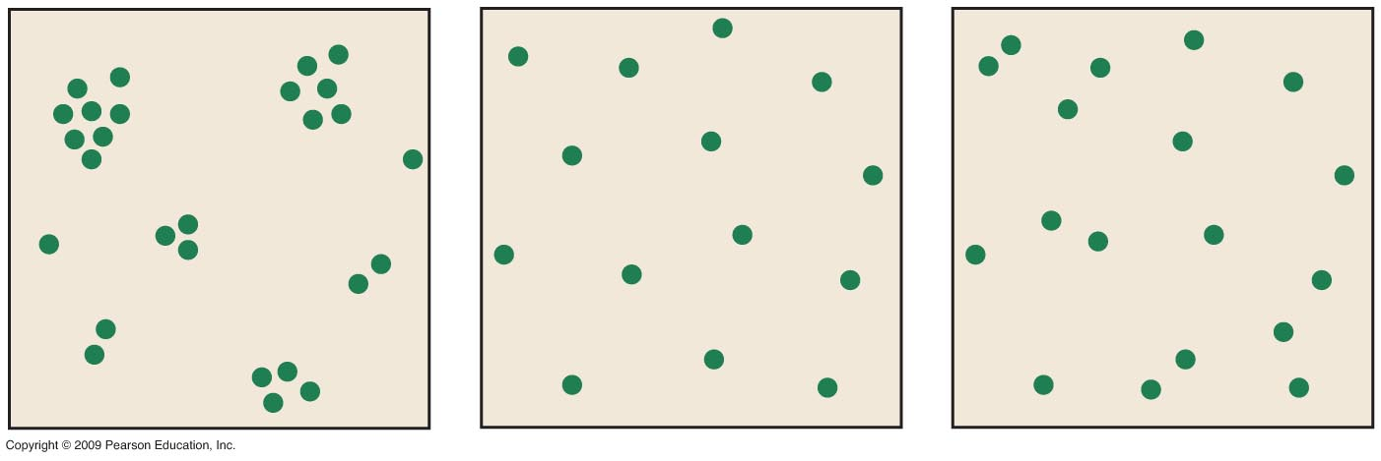
0
Notes:
Figure 36.2A Clumped dispersion of schooling fish.
Figure 36.2B Uniform dispersion of nesting king penguins.
Figure 36.2C Random dispersion of dandelions.

Slide 8
Density and Dispersion Patterns
0
The dispersion pattern of a population refers to the way individuals are spaced within their area
Dispersion patterns can be
Clumped
Uniform
Random
Copyright © 2009 Pearson Education, Inc.
Notes:
Student Misconceptions and Concerns
1. Many students who are not biology majors have trouble thinking about the evolution of systems. One analogy that can be developed, especially for economically-minded students, is the parallels to the “evolution” of businesses. Consider the introduction and expansion of McDonald’s restaurants in the United States over the last 50 years. When McDonald’s restaurants were just starting out, they experienced little competition, with access to many customers. The “population” of McDonald’s restaurants in the United States grew exponentially (or nearly so), with few density dependent factors. However, today McDonald’s restaurants in the U.S. must compete with each other, as well as with many other fast-food restaurants, such as Burger King and Taco Bell. The population of McDonald’s restaurants in the United States has stabilized because of this competition for customers, a density dependent factor. A graph of the growth of McDonald’s restaurants in the United States would likely resemble the lazy “S” shape.
Teaching Tips
1. A simple application of the dispersion pattern of a population would be to apply the concept to the population of humans on your college or university campus. Would students consider the distribution of people to be clumped, uniform, or random? Most campuses would likely represent a clumped pattern. It might be fun to discuss when, if ever, the human population on your campus represents a uniform or random pattern.

Slide 9
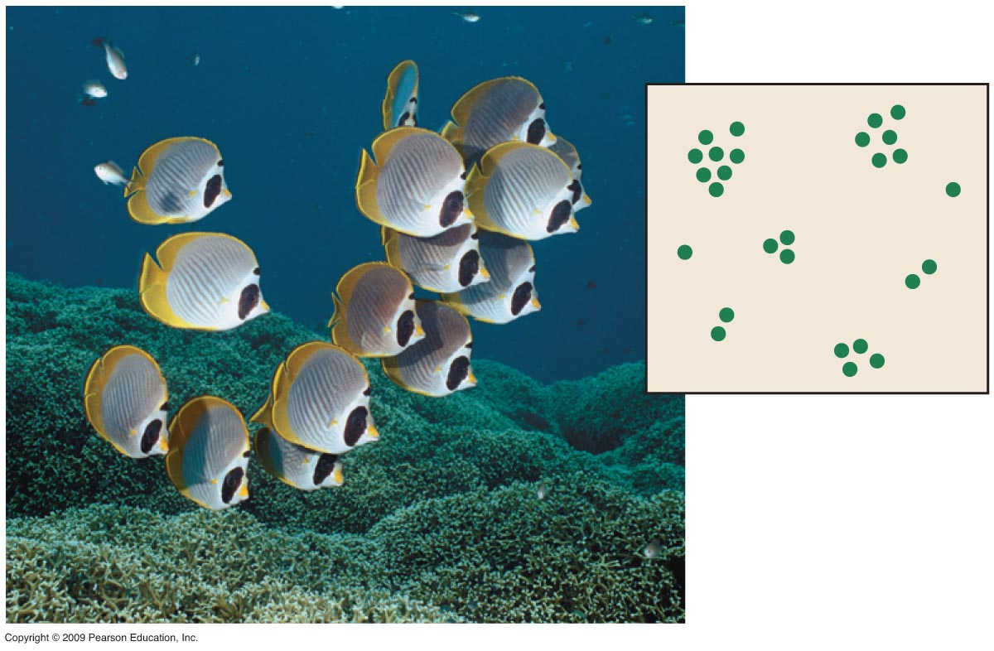
Density and Dispersion Patterns
0
In a clumped pattern individuals are grouped in patches
Copyright © 2009 Pearson Education, Inc.
Notes:
Student Misconceptions and Concerns
1. Many students who are not biology majors have trouble thinking about the evolution of systems. One analogy that can be developed, especially for economically-minded students, is the parallels to the “evolution” of businesses. Consider the introduction and expansion of McDonald’s restaurants in the United States over the last 50 years. When McDonald’s restaurants were just starting out, they experienced little competition, with access to many customers. The “population” of McDonald’s restaurants in the United States grew exponentially (or nearly so), with few density dependent factors. However, today McDonald’s restaurants in the U.S. must compete with each other, as well as with many other fast-food restaurants, such as Burger King and Taco Bell. The population of McDonald’s restaurants in the United States has stabilized because of this competition for customers, a density dependent factor. A graph of the growth of McDonald’s restaurants in the United States would likely resemble the lazy “S” shape.
Teaching Tips
1. A simple application of the dispersion pattern of a population would be to apply the concept to the population of humans on your college or university campus. Would students consider the distribution of people to be clumped, uniform, or random? Most campuses would likely represent a clumped pattern. It might be fun to discuss when, if ever, the human population on your campus represents a uniform or random pattern.

Slide 10
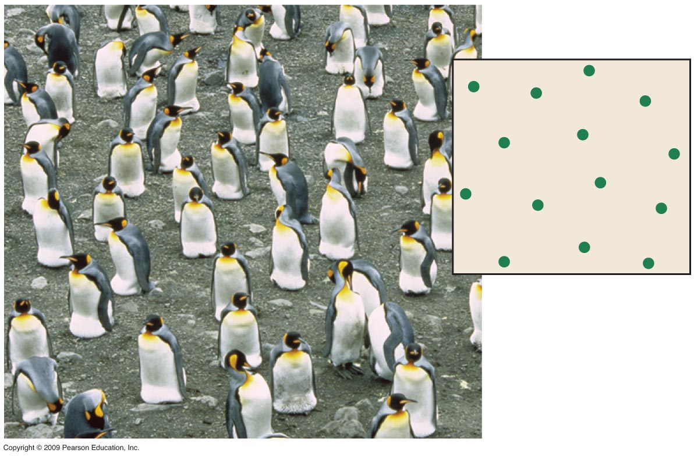
Density and Dispersion Patterns
0
In a uniform pattern individuals are equally spaced in the environment
Copyright © 2009 Pearson Education, Inc.
Notes:
Student Misconceptions and Concerns
1. Many students who are not biology majors have trouble thinking about the evolution of systems. One analogy that can be developed, especially for economically-minded students, is the parallels to the “evolution” of businesses. Consider the introduction and expansion of McDonald’s restaurants in the United States over the last 50 years. When McDonald’s restaurants were just starting out, they experienced little competition, with access to many customers. The “population” of McDonald’s restaurants in the United States grew exponentially (or nearly so), with few density dependent factors. However, today McDonald’s restaurants in the U.S. must compete with each other, as well as with many other fast-food restaurants, such as Burger King and Taco Bell. The population of McDonald’s restaurants in the United States has stabilized because of this competition for customers, a density dependent factor. A graph of the growth of McDonald’s restaurants in the United States would likely resemble the lazy “S” shape.
Teaching Tips
1. A simple application of the dispersion pattern of a population would be to apply the concept to the population of humans on your college or university campus. Would students consider the distribution of people to be clumped, uniform, or random? Most campuses would likely represent a clumped pattern. It might be fun to discuss when, if ever, the human population on your campus represents a uniform or random pattern.

Slide 11
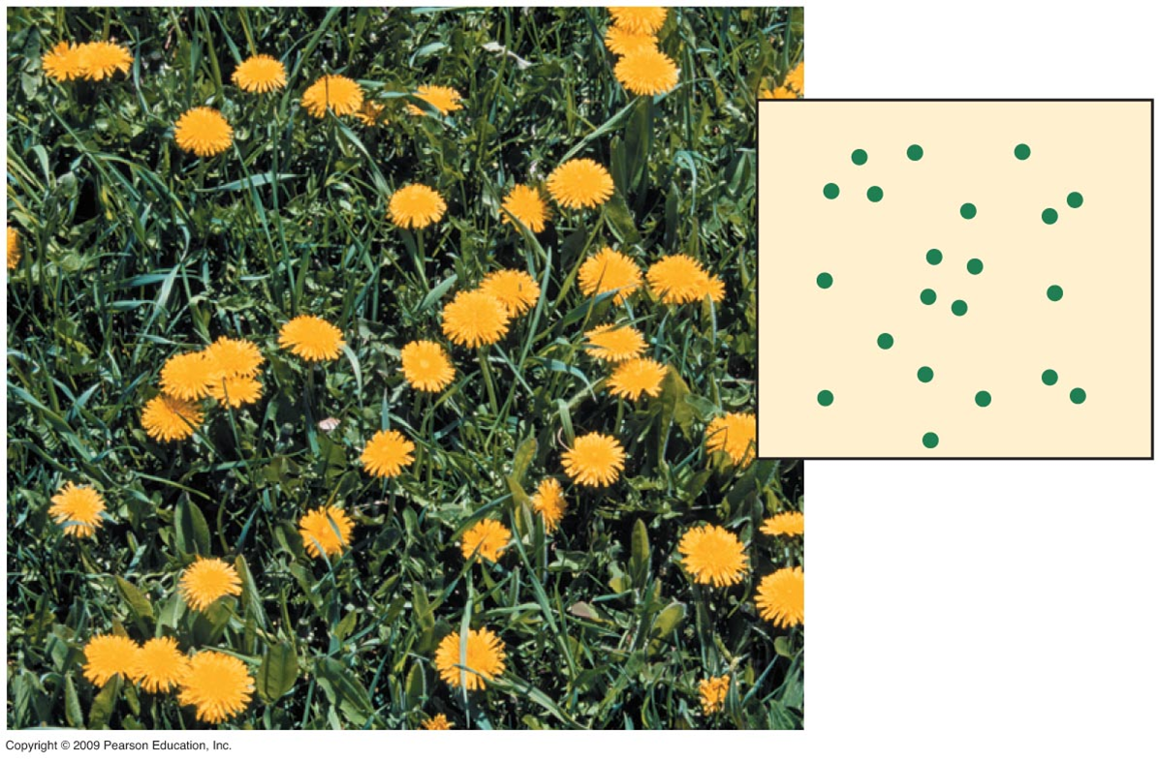
Density and Dispersion Patterns
0
In a random pattern of dispersion, the individuals in a population are spaced in an unpredictable way
Copyright © 2009 Pearson Education, Inc.
Notes:
Student Misconceptions and Concerns
1. Many students who are not biology majors have trouble thinking about the evolution of systems. One analogy that can be developed, especially for economically-minded students, is the parallels to the “evolution” of businesses. Consider the introduction and expansion of McDonald’s restaurants in the United States over the last 50 years. When McDonald’s restaurants were just starting out, they experienced little competition, with access to many customers. The “population” of McDonald’s restaurants in the United States grew exponentially (or nearly so), with few density dependent factors. However, today McDonald’s restaurants in the U.S. must compete with each other, as well as with many other fast-food restaurants, such as Burger King and Taco Bell. The population of McDonald’s restaurants in the United States has stabilized because of this competition for customers, a density dependent factor. A graph of the growth of McDonald’s restaurants in the United States would likely resemble the lazy “S” shape.
Teaching Tips
1. A simple application of the dispersion pattern of a population would be to apply the concept to the population of humans on your college or university campus. Would students consider the distribution of people to be clumped, uniform, or random? Most campuses would likely represent a clumped pattern. It might be fun to discuss when, if ever, the human population on your campus represents a uniform or random pattern.

Slide 12
Life tables track survivorship in populations
0
Life tables track survivorship over the life span of individuals in a population
Survivorship curves plot the proportion of individuals alive at each age
Type I
Type II
Type III
Copyright © 2009 Pearson Education, Inc.
Notes:
Student Misconceptions and Concerns
1. Many students who are not biology majors have trouble thinking about the evolution of systems. One analogy that can be developed, especially for economically-minded students, is the parallels to the “evolution” of businesses. Consider the introduction and expansion of McDonald’s restaurants in the United States over the last 50 years. When McDonald’s restaurants were just starting out, they experienced little competition, with access to many customers. The “population” of McDonald’s restaurants in the United States grew exponentially (or nearly so), with few density dependent factors. However, today McDonald’s restaurants in the U.S. must compete with each other, as well as with many other fast-food restaurants, such as Burger King and Taco Bell. The population of McDonald’s restaurants in the United States has stabilized because of this competition for customers, a density dependent factor. A graph of the growth of McDonald’s restaurants in the United States would likely resemble the lazy “S” shape.
Teaching Tips
1. The Centers for Disease Control provide information and life tables for people living in the United States at their website, www.cdc.gov/nchs/products/pubs/pubd/lftbls/life/1966.htm.

Slide 13
Notes:
Table 36.3 Life Table for the U.S. Population in 2003.

Slide 14
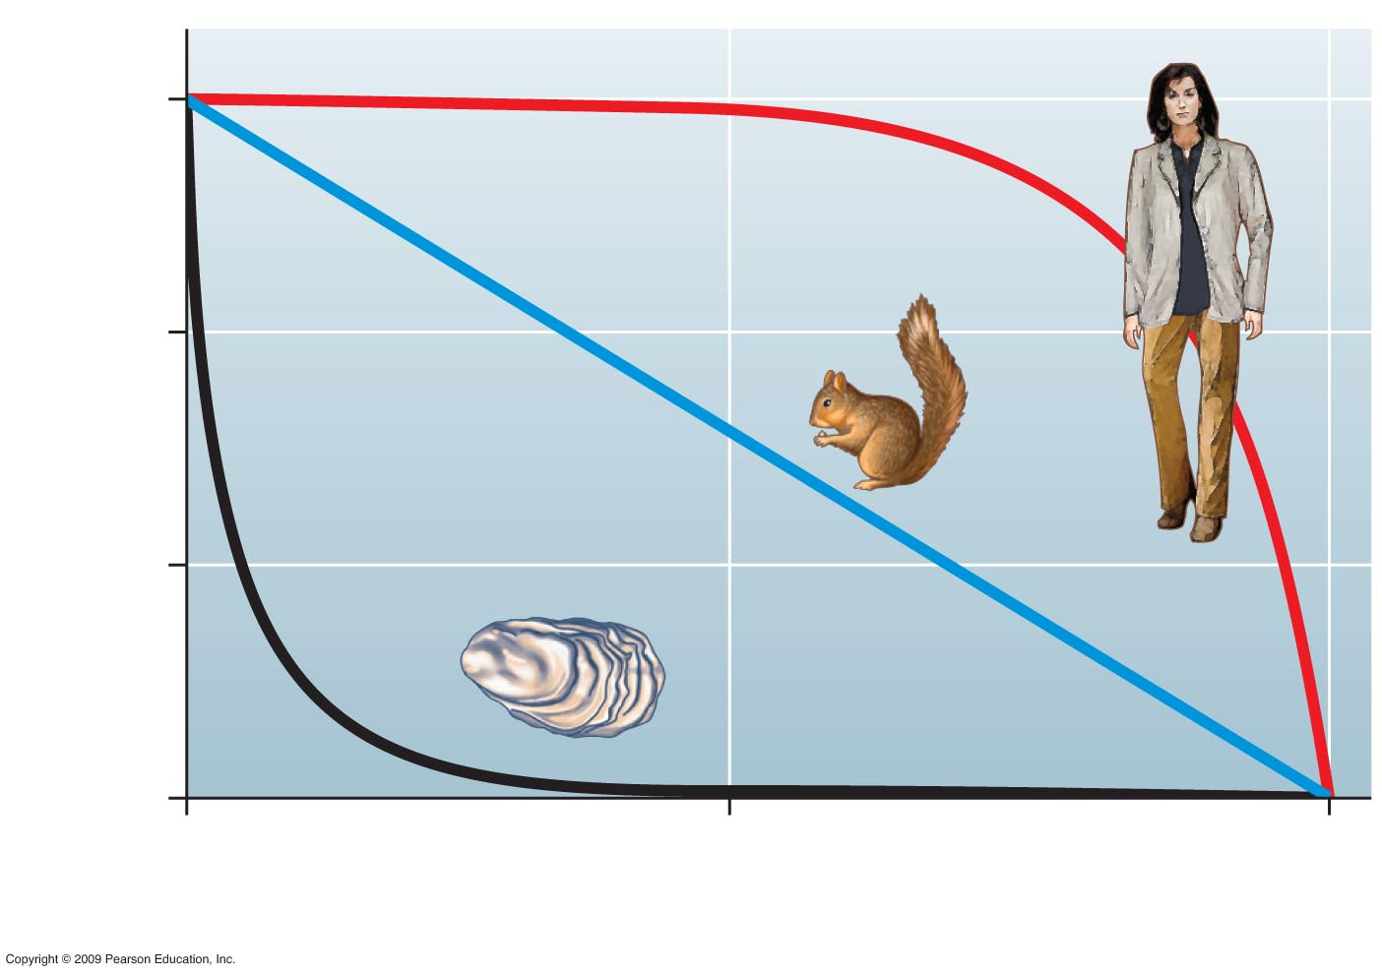
100
I
10
Percentage of survivors (log scale)
II
1
III
0.1
0
50
100
Percentage of maximum life span
Notes:
Figure 36.3 Three types of survivorship curves.

