Slide 1
Genetic Engineering
0
Genetic engineering involves manipulating genes for practical purposes
Gene cloning leads to the production of multiple identical copies of a gene-carrying piece of DNA
Recombinant DNA is formed by joining DNA sequences from two different sources
One source contains the gene that will be cloned
Another source is a gene carrier, called a vector
Plasmids (small, circular DNA molecules independent of the bacterial chromosome) are often used as vectors
Copyright © 2009 Pearson Education, Inc.
Notes:
Student Misconceptions and Concerns
1. Student comprehension of restriction enzymes, nucleic acid probes, and many other aspects of recombinant DNA techniques depends upon a comfortable understanding of basic molecular genetics. Consider addressing Chapter 12 after an exam that covers the content in Chapters 10 and 11.
2. Students might bring some awareness and/or concerns about biotechnology to the classroom, for example, in their reactions to the controversies regarding genetically modified (GM) foods. This experience can be used to generate class interest and to highlight the importance of good information when making judgments. Consider starting class with a headline addressing one of these issues.
Teaching Tips
1. Figure 12.1 is a synthesis of the techniques discussed in further detail in Modules 12.2–12.5. Figure 12.1 is therefore an important integrative piece that lays the foundation of most of the biotechnology discussion. Referring to this figure in class helps students relate the text to your lecture.
2. The general genetic engineering challenge discussed in Module 12.1 begins with the need to insert a gene of choice into a plasmid. This process is very similar to film or video editing. What do we need to do to insert a minute of one film into another? We will need techniques to cut and remove the minute of film and a way to cut the new film apart and insert the new minute. In general, this is also like removing one boxcar from one train, and transferring the boxcar to another train. Students can become confused by the details of gene cloning through misunderstanding this basic relationship.

Slide 2
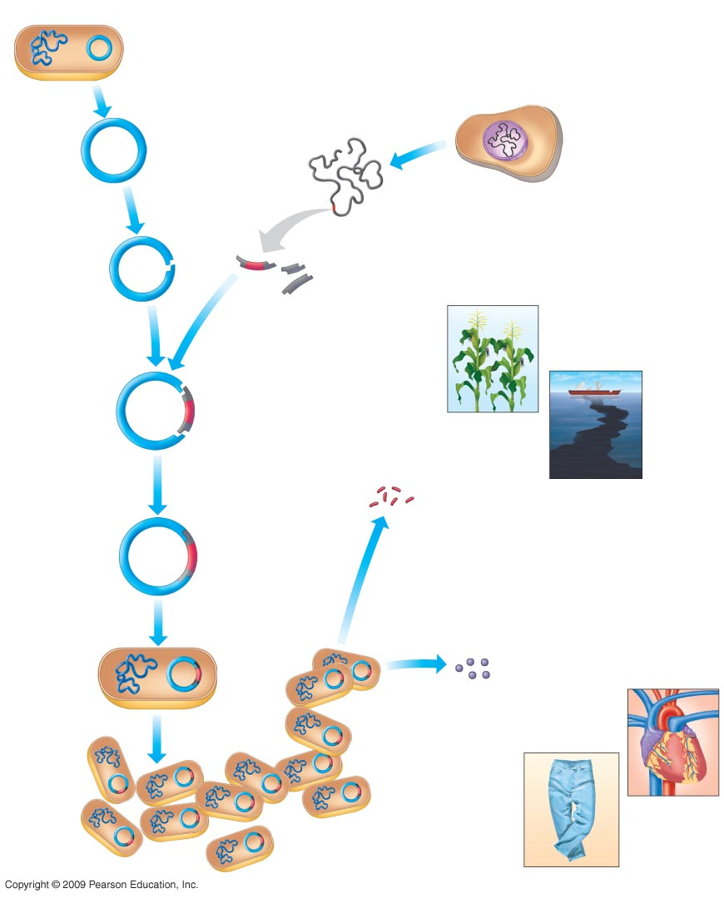
E. coli bacterium
Plasmid
0
Cell with DNA
containing gene
of interest
Bacterial
chromosome
1
Isolate
plasmid
2
Isolate
DNA
3
Cut plasmid
with enzyme
DNA
Gene of interest
4
Cut cell’s DNA
with same enzyme
Gene
of interest
5
Combine targeted fragment
and plasmid DNA
Examples of
gene use
6
Add DNA ligase,
which closes
the circle with
covalent bonds
Genes may be inserted
into other organisms
Recombinant
DNA
plasmid
Gene
of interest
7
Put plasmid
into bacterium
by transformation
9
Genes or proteins
are isolated from the
cloned bacterium
Recombinant
bacterium
Harvested
proteins
may be
used directly
Examples of
protein use
8
Allow bacterium
to reproduce
Clone
of cells
Notes:
Figure 12.1 An overview of gene cloning.
This figure shows steps 1–8 as detailed on the previous two slides.

Slide 3
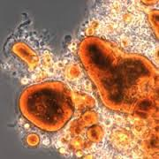
Oil Spills & Microbes

