Slide 1
Natural Selection
Microevolution

Slide 2
Microevolution
How does evolution take place??
Changes in the allele frequency of a population
Changes in the allele frequency changes the population’s gene pool
Gene pool: all copies of every allele type in all members of the population
Microevolution: evolution occurring at the smallest scale—at the level of single population

Slide 3
What can change allele frequency?
1. Natural Selection
2. Mutation
3. Sexual Selection
4. Genetic Drift
5. Gene Flow

Slide 4
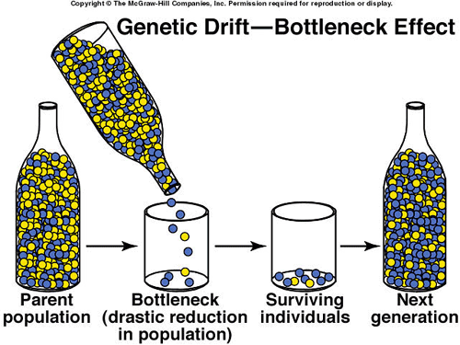
Genetic Drift Types
Genetic Drift: random chance events that cause allele frequency to change
Bottleneck Effect: an event that causes a drastic reduction in population size
Examples: fires, floods, hurricanes, etc.
Leaves small number of survivors=small number of possible alleles
Founder Effect: few individuals become isolated from the rest of the population and form a new population
Islands very common
Human population on Tristan da Cunha island
15 colonists and 1 with recessive retina disorder
Population shows 10X higher rate of disorder

