Slide 1
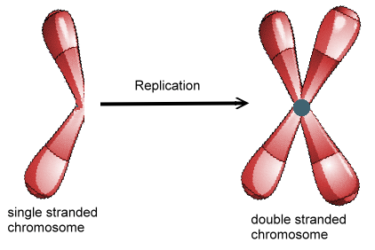
DNA REPLICATION
Making sister chromatids!

Slide 2
DNA Structure
Double Stranded
Backbone
Phosphate
Sugar (deoxyribose)
“Rungs of the Ladder”
Nitrogenous Base (Adenine, Cytosine, Guanine, Thymine)
Two stands twist together to form double helix

Slide 3
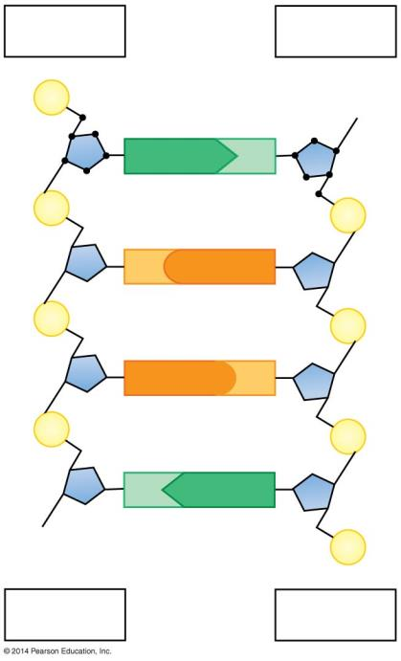
Figure 10.5b
5′ end
3′ end
P
HO
5′
4′
2′
3′
A
T
3′
1′
1′
4′
2′
P
5′
P
C
G
P
P
G
C
P
P
T
A
OH
P
3′ end
5′ end
Notes:
Figure 10.5b The opposite orientations of DNA strands

Slide 4
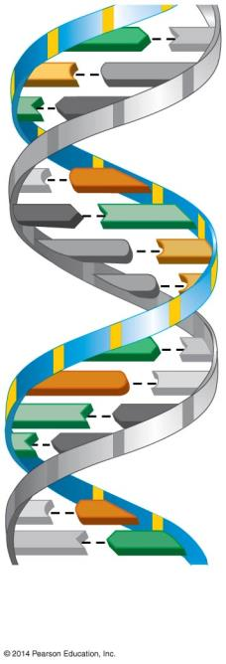
Figure 10.2a-1
A
T
C
G
T
A
DNA double helix
C
G
A
T
G
C
G
A
T
G
C
T
A
T
A
C
G
T
A
Notes:
Figure 10.2a-1 The structure of a DNA polynucleotide (part 1)

Slide 5
DNA replication: depends on specific base pairing
DNA replication follows a semiconservative model
The two DNA strands separate.
Each strand then becomes a template for the assembly of a complementary strand
Each new DNA helix has one old strand with one new strand.
Notes:
Student Misconceptions and Concerns
• The authors note that although the general process of semiconservative DNA replication is relatively simple, it is actually quite complex. The DNA molecule is unwound, each strand is copied simultaneously, the correct bases are inserted, and the product is proofread and corrected. Before discussing these details, be sure that your students understand the overall process, what is accomplished, and why each step is important.
Teaching Tips
• The semiconservative model of DNA replication is like making a photo from a negative and then a new negative from the photo. In each new negative and photo pair, the new item was made from an old item.
Active Lecture Tips
• Demonstrate the complementary base pairing within DNA. Present students with the base sequence to one side of a DNA molecule and have them work in pairs at their seats to quickly determine the sequence of the complementary strand. For some students, these sorts of quick practice are necessary to reinforce a concept and break up a lecture.
• See the Activity I’m Not Sure I Liked James Watson: Using a Video to Tell the Most Exciting Discovery in Biology on the Instructor Exchange. Visit the Instructor Exchange in the MasteringBiology instructor resource area for a description of this activity.

Slide 6
Figure 10.4a-1
A
T
C
G
G
C
A
T
T
A
A parental molecule of DNA
Notes:
Figure 10.4a-1 A template model for DNA replication (step 1)

Slide 7
Figure 10.4a-2
A
T
A
T
A
T
C
G
C
G
C
G
G
C
G
C
C
A
T
A
A
T
T
A
T
Free nucleotides
A
A parental molecule of DNA
The parental strands separate
and serve as templates
Notes:
Figure 10.4a-2 A template model for DNA replication (step 2)

Slide 8
Figure 10.4a-3
A
T
A
T
A
T
A
T
A
T
C
G
C
G
C
G
C
G
C
G
G
C
G
C
C
G
C
G
C
A
T
A
A
T
A
T
A
T
T
A
T
Free nucleotides
A
T
A
T
A
A parental molecule of DNA
The parental strands separate
and serve as templates
Two identical daughter molecules of DNA are formed
Notes:
Figure 10.4a-3 A template model for DNA replication (step 3)

Slide 9
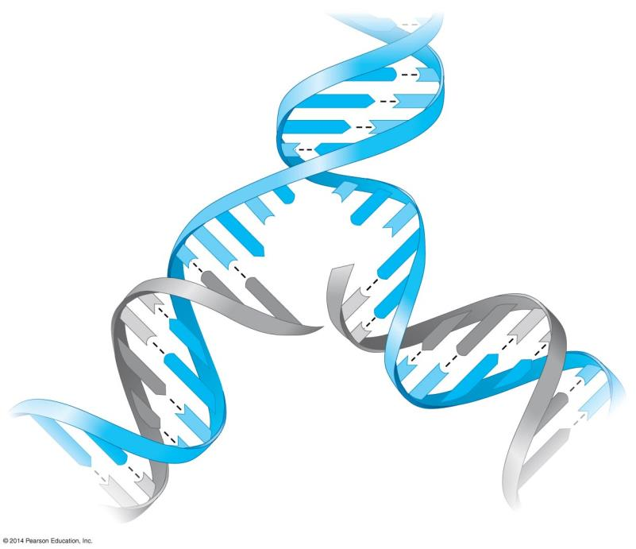
Figure 10.4b
A
T
G
C
A
T
A
T
Parental DNA molecule
T
A
C
G
G
C
T
Daughter strand
A
Parental strand
C
C
G
G
G
C
T
G
A
C
A
T
T
C
G
G
T
A
A
C
C
A
G
T
A
T
A
A
G
T
Daughter DNA molecules
T
C
Notes:
Figure 10.4b The untwisting and replication of DNA

Slide 10
DNA replication proceeds in two directions at many sites simultaneously
Replication of a DNA molecule begins at sites called origins of replication: short stretches of DNA having a specific sequence of nucleotides.
Proteins that initiate DNA replication
attach to the DNA at the origin of replication and
separate the two strands of the double helix.
Replication then proceeds in both directions, creating replication “bubbles.”
Notes:
Student Misconceptions and Concerns
• The authors note that although the general process of semiconservative DNA replication is relatively simple, it is actually quite complex. The DNA molecule is unwound, each strand is copied simultaneously, the correct bases are inserted, and the product is proofread and corrected. Before discussing these details, be sure that your students understand the overall process, what is accomplished, and why each step is important.
Teaching Tips
• To explain the adaptive advantage of multiple replication sites over a single site of replication, ask the students to imagine copying, by hand, the first ten chapters of your biology textbook. The task would certainly go faster if ten students each copied a different chapter.
• There are about 500,000 words in the Biology: Concepts & Connections textbook. The accuracy of DNA replication would be like copying every word in this textbook by hand 2,000 times and writing just one word incorrectly, making one uncorrected error in every 1 billion words.

Slide 11
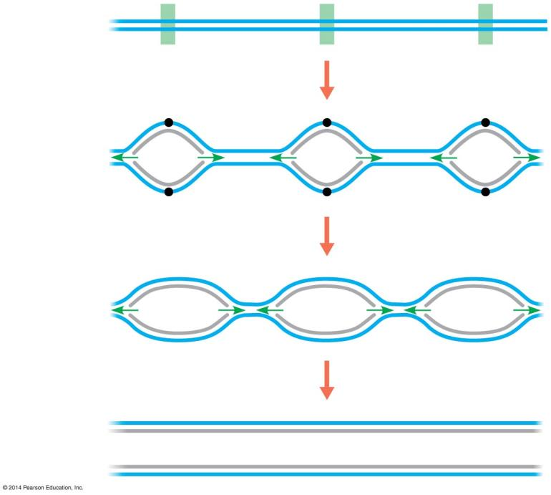
Figure 10.5a
Parental DNA molecule
Origin of replication
Parental strand
Daughter strand
“Bubble”
Two daughter DNA molecules
Notes:
Figure 10.5a Multiple bubbles in replicating DNA

Slide 12
DNA replication proceeds in two directions at many sites simultaneously
DNA replication occurs in the 5′ to 3′ direction.
DNA polymerase only reads the template 3′ to 5′.
New strand then goes 5′ to 3′ as it is built.
Because of this: Replication is discontinuous on the 5′ to 3′ template, forming short Okazaki fragments.
An enzyme, called DNA ligase, links (or ligates) the pieces together into a single DNA strand.
Notes:
Student Misconceptions and Concerns
• The authors note that although the general process of semiconservative DNA replication is relatively simple, it is actually quite complex. The DNA molecule is unwound, each strand is copied simultaneously, the correct bases are inserted, and the product is proofread and corrected. Before discussing these details, be sure that your students understand the overall process, what is accomplished, and why each step is important.
Teaching Tips
• To explain the adaptive advantage of multiple replication sites over a single site of replication, ask the students to imagine copying, by hand, the first ten chapters of your biology textbook. The task would certainly go faster if ten students each copied a different chapter.
• There are about 500,000 words in the Biology: Concepts & Connections textbook. The accuracy of DNA replication would be like copying every word in this textbook by hand 2,000 times and writing just one word incorrectly, making one uncorrected error in every 1 billion words.

Slide 13
Figure 10.5b
5′ end
3′ end
P
HO
5′
4′
2′
3′
A
T
3′
1′
1′
4′
2′
P
5′
P
C
G
P
P
G
C
P
P
T
A
OH
P
3′ end
5′ end
Notes:
Figure 10.5b The opposite orientations of DNA strands

Slide 14
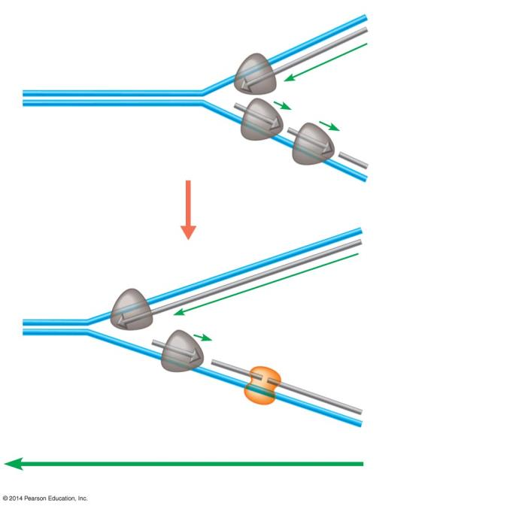
Figure 10.5c
DNA polymerase molecule
3′
5′
This daughter strand is synthesized continuously
Parental DNA
5′
3′
Replication fork
This daughter strand is synthesized in pieces
3′
5′
5′
3′
DNA ligase
Overall direction of replication
Notes:
Figure 10.5c How daughter DNA strands are synthesized

Slide 15
DNA replication proceeds in two directions at many sites simultaneously
DNA polymerases and DNA ligase also repair DNA damaged by harmful radiation and toxic chemicals.
DNA replication ensures that all the somatic cells in a multicellular organism carry the same genetic information.
Notes:
Student Misconceptions and Concerns
• The authors note that although the general process of semiconservative DNA replication is relatively simple, it is actually quite complex. The DNA molecule is unwound, each strand is copied simultaneously, the correct bases are inserted, and the product is proofread and corrected. Before discussing these details, be sure that your students understand the overall process, what is accomplished, and why each step is important.
Teaching Tips
• To explain the adaptive advantage of multiple replication sites over a single site of replication, ask the students to imagine copying, by hand, the first ten chapters of your biology textbook. The task would certainly go faster if ten students each copied a different chapter.
• There are about 500,000 words in the Biology: Concepts & Connections textbook. The accuracy of DNA replication would be like copying every word in this textbook by hand 2,000 times and writing just one word incorrectly, making one uncorrected error in every 1 billion words.

