Slide 1
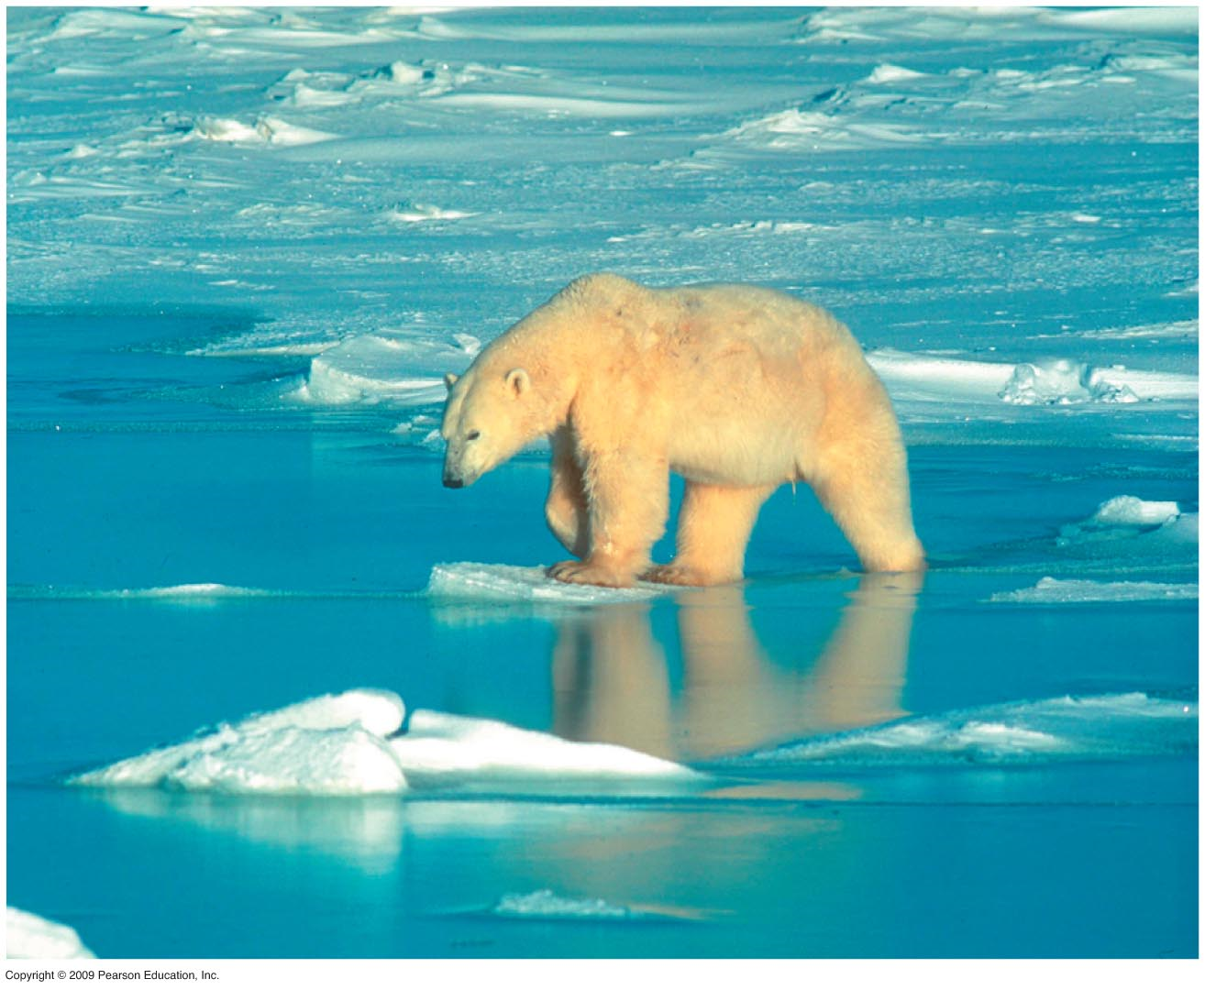
Rapid warming is changing the global climate
0
The scientific debate about global warming is over—cause of warming is still debated
Global temperature has risen
0.8°C in the last 100 years
0.6°C of that increase occurred in the last three decades
2 to 4.5°C increases are likely by the end of the 21st century
Global warming most evident in arctic
Shrinking sea ice
Thinning ice sheets
Melting permafrost
Notes:
Student Misconceptions and Concerns
1. The importance of biodiversity may not be obvious to many students. Yet, as this chapter notes, biodiversity is inherently valuable on many levels. Consider challenging your class to explain why biodiversity matters, as an introduction to the subject.
2. Frustration can overwhelm students who are alarmed by the many problems addressed in this chapter. One way to address this is to provide meaningful ways for students to respond to this information (for example, changes in personal choices and voting). Several related websites are noted in the Teaching Tips below.
3. Students often confuse the causes and consequences of global warming and the destruction of the ozone layer. Instructors should take care to distinguish between these two global problems.
Teaching Tips
1. Many students do not realize that greenhouses get very warm when exposed to strong sunlight. (Most of them have probably never even been inside a greenhouse.) However, most students understand that a closed car gets warmer when sitting in the sun (thus the need for the various windshield sun reflectors). The glass in the car functions just like the glass in a greenhouse.
2. Additional details on the greenhouse effect can be found at the following websites. NASA’s Global Change Master Directory: http://gcmd.nasa.gov/Resources/pointers/glob_warm.html
NASA: www.giss.nasa.gov/edu/gwdebate/
The National Academy of Sciences: http://dels.nas.edu/globalchange/
The National Climatic Data Center: www.ncdc.noaa.gov/oa/climate/globalwarming.html
The Australian Greenhouse Office: www.greenhouse.gov.au
3. In 2007, former U.S. Vice President Al Gore and the Intergovernmental Panel on Climate Change (IPCC) received the Nobel Peace Prize “for their efforts to build up and disseminate greater knowledge about man-made climate change, and to lay the foundations for the measures that are needed to counteract such change.” The full statement of the Nobel Prize committee can be found at http://nobelprize.org/nobel_prizes/peace/laureates/2007/.

Slide 2
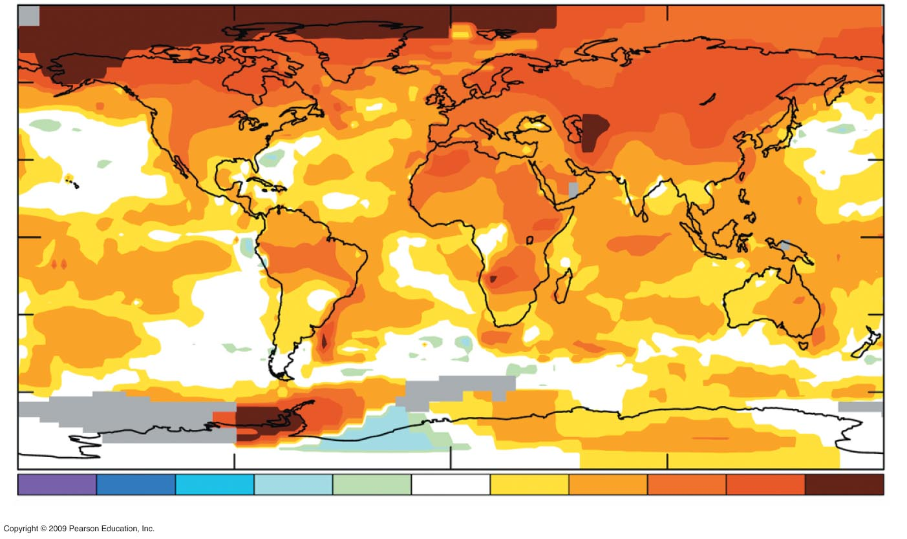
–2
–1.6
–1.2
–.8
–.4
–.2
.2
.4
.8
1.2
1.6
2.1
Notes:
Figure 38.5A 2000–2005 temperature deviations relative to 1951–1980 (ºC).

Slide 3
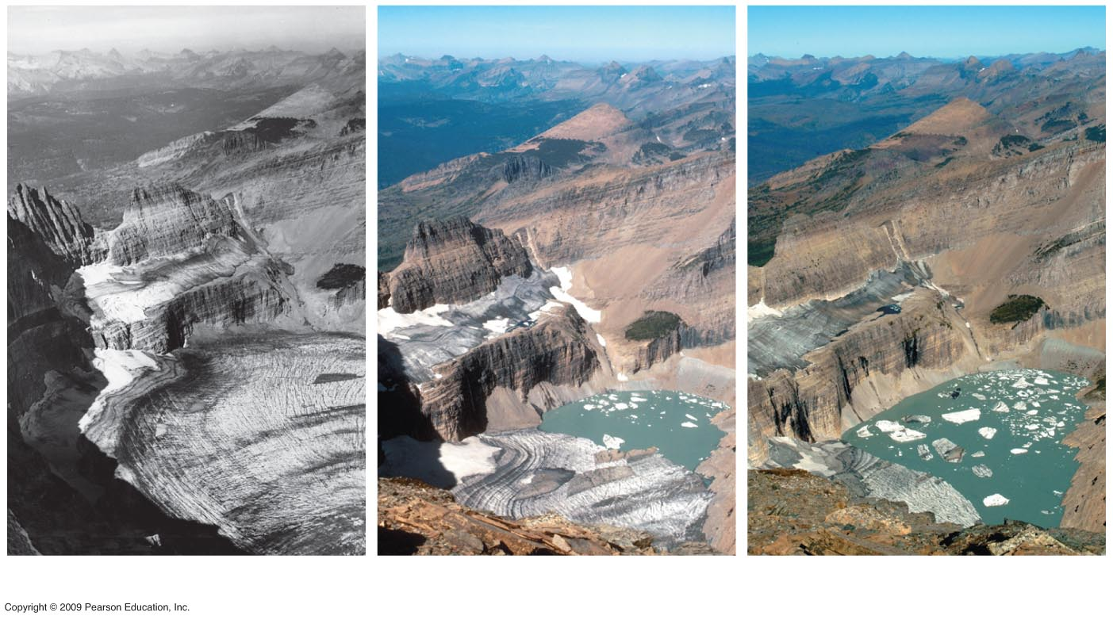
Grinnell Glacier: Glacier National Park Montana
1938
1981
2005
Notes:
Figure 38.5B Grinell Glacier in Glacier National Park, 1938 (left), 1981 (center), and 2005 (right).

Slide 4
Human activities are responsible for rising concentrations of greenhouse gases
0
Atmospheric CO₂ did not exceed 300 ppm for 650,000 years
Atmospheric CO₂ is approximately 385 ppm today
High levels of methane and nitrous oxide also trap heat
Notes:
Student Misconceptions and Concerns
1. The importance of biodiversity may not be obvious to many students. Yet, as this chapter notes, biodiversity is inherently valuable on many levels. Consider challenging your class to explain why biodiversity matters, as an introduction to the subject.
2. Frustration can overwhelm students who are alarmed by the many problems addressed in this chapter. One way to address this is to provide meaningful ways for students to respond to this information (for example, changes in personal choices and voting). Several related websites are noted in the Teaching Tips below.
Teaching Tips
1. Many students do not realize that greenhouses get very warm when exposed to strong sunlight. (Most of them have probably never even been inside a greenhouse.) However, most students understand that a closed car gets warmer when sitting in the sun (thus the need for the various windshield sun reflectors). The glass in the car functions just like the glass in a greenhouse.
2. Additional details on the greenhouse effect can be found at the following websites. NASA’s Global Change Master Directory: http://gcmd.nasa.gov/Resources/pointers/glob_warm.html
NASA: www.giss.nasa.gov/edu/gwdebate/
The National Academy of Sciences: http://dels.nas.edu/globalchange/
The National Climatic Data Center: www.ncdc.noaa.gov/oa/climate/globalwarming.html
The Australian Greenhouse Office: www.greenhouse.gov.au
3. In 2007, former U.S. Vice President Al Gore and the Intergovernmental Panel on Climate Change (IPCC) received the Nobel Peace Prize “for their efforts to build up and disseminate greater knowledge about man-made climate change, and to lay the foundations for the measures that are needed to counteract such change.” The full statement of the Nobel Prize committee can be found at http://nobelprize.org/nobel_prizes/peace/laureates/2007/.

Slide 5
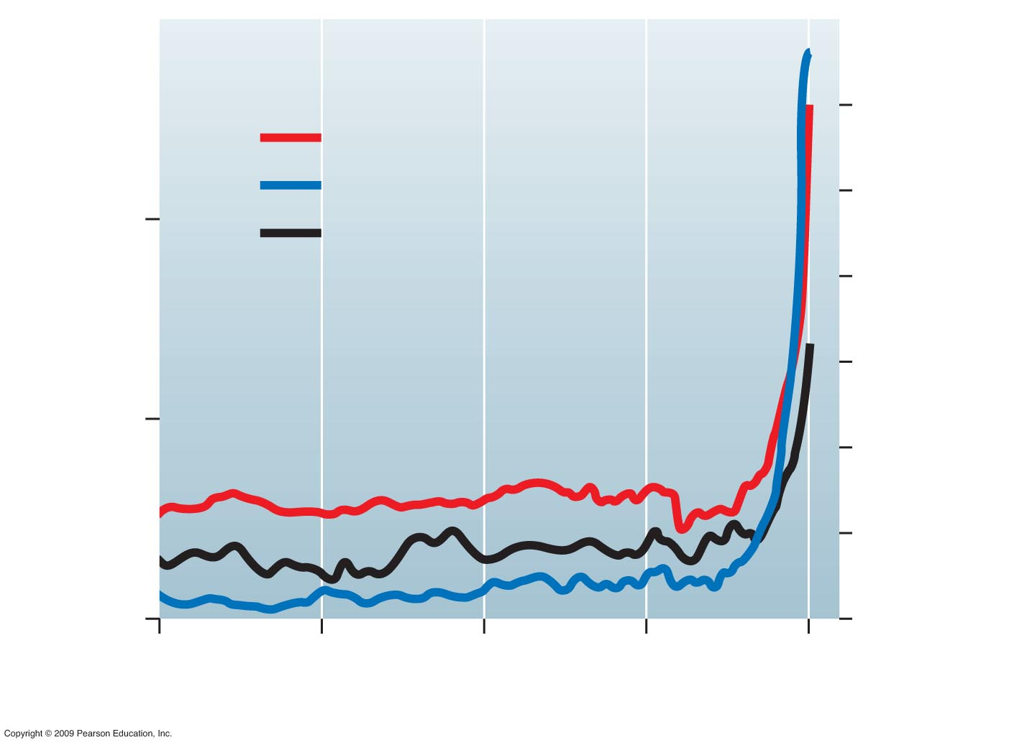
400
2000
1800
Carbon Dioxide (CO₂)
Methane (CH₄)
1600
350
Nitrous Oxide (N₂O)
1400
CO₂ (ppm), N₂O (ppb)
CH₄ (ppb)
1200
300
1000
800
250
600
0
500
1000
1500
2000
Year
Notes:
Figure 38.6A Atmospheric concentrations of CO₂, N₂O (y-axis on left) and CH₄ (y-axis on right).

Slide 6
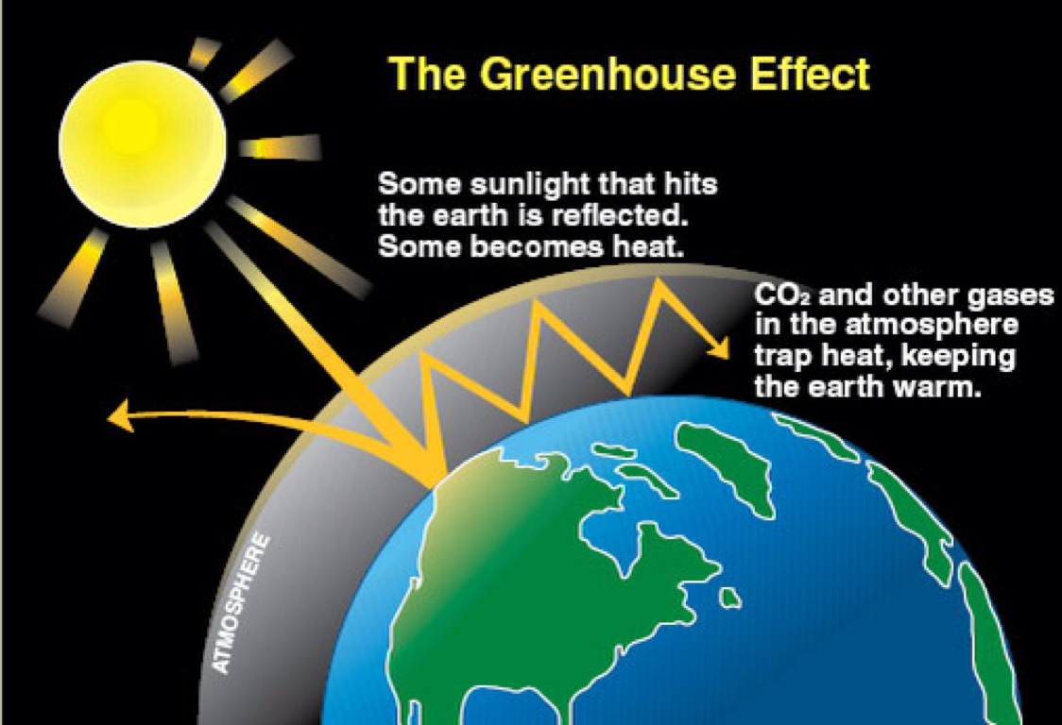
Notes:
Figure 38.6B Carbon cycling.

Slide 7
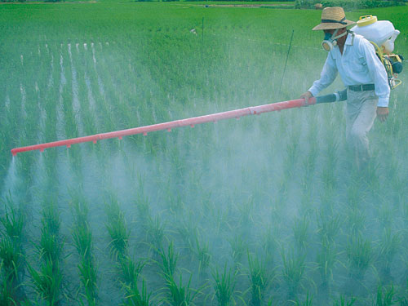
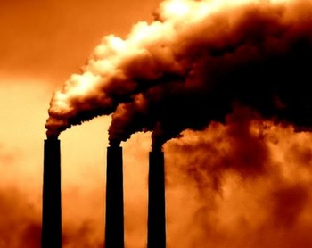
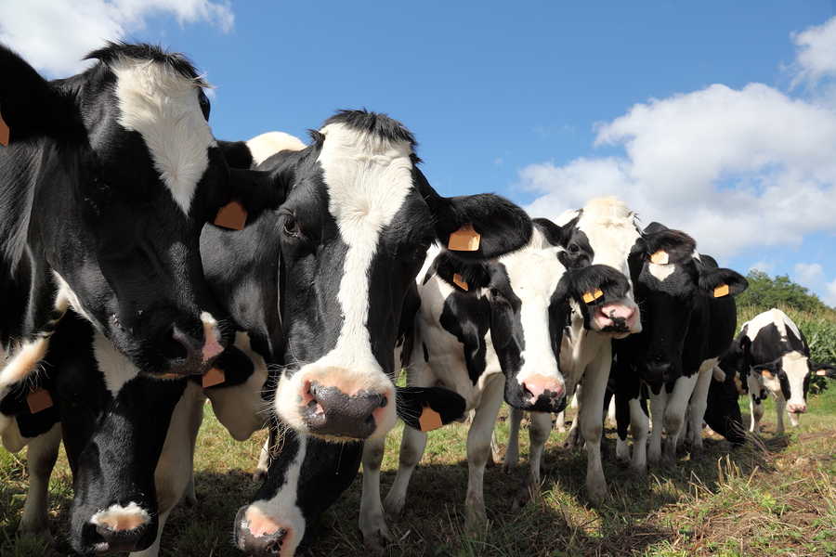
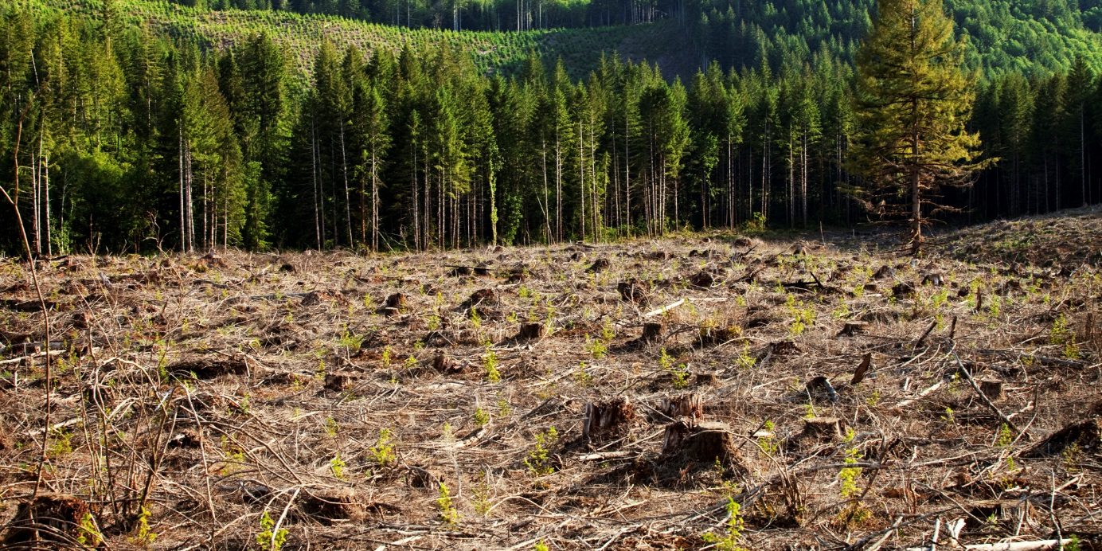
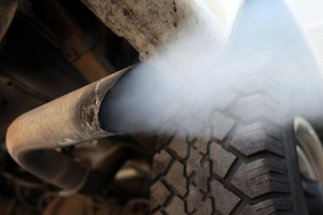
The Greenhouse Effect: Causes
CO2 into the atmosphere from fossil fuels (coal)
CO2 into the atmosphere from burning gasoline
Methane emissions from livestock (cows! And melting ice)
Deforestation
Chemical Fertilizers

Slide 8
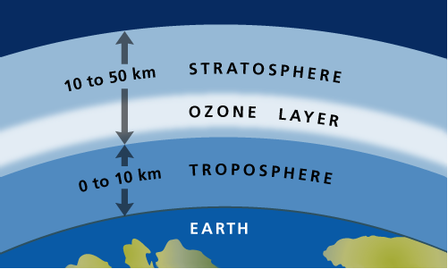
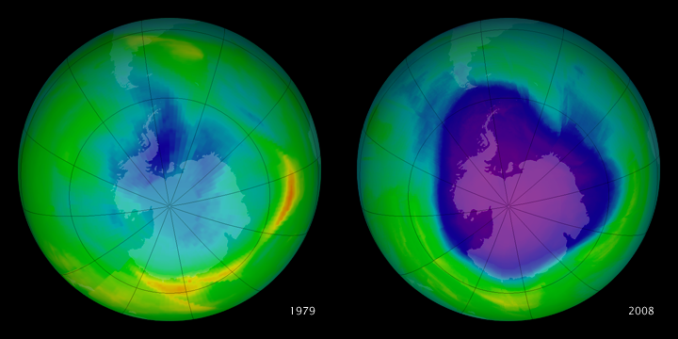
Greenhouse Effect vs. Ozone Loss
Ozone protects Earth from harmful UV light
Lower stratosphere
Hole caused by CFCs
Unrelated to Greenhouse gases and warming

Slide 9
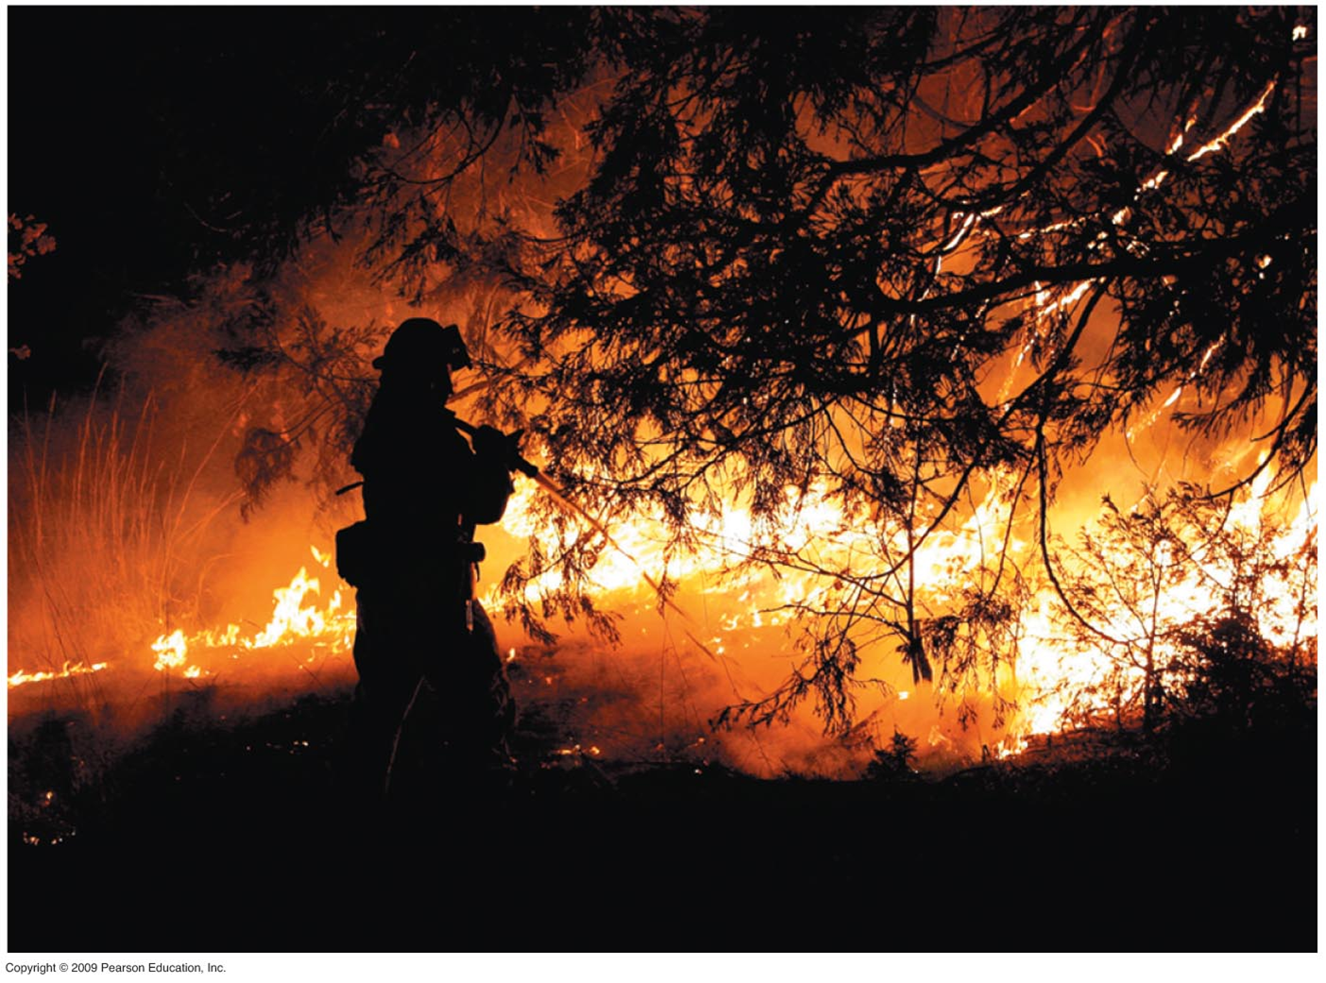
Global climate change affects biomes, ecosystems, communities, and populations
0
Terrestrial biomes determined by temperature and rainfall
Changing as a consequence of global warming
Distributions of populations and species also changing
Disappearance of many species being caused by changing climate
Climate change affects seasonal events in some plants and animals
Notes:
Student Misconceptions and Concerns
1. The importance of biodiversity may not be obvious to many students. Yet, as this chapter notes, biodiversity is inherently valuable on many levels. Consider challenging your class to explain why biodiversity matters, as an introduction to the subject.
2. Frustration can overwhelm students who are alarmed by the many problems addressed in this chapter. One way to address this is to provide meaningful ways for students to respond to this information (for example, changes in personal choices and voting). Several related websites are noted in the Teaching Tips below.
Teaching Tips
1. Students are unlikely to enter the course with a prior understanding of the diverse impacts of global climate change on ecosystems and individual species. Concepts such as the increased spread of disease vectors, the shifting of natural ranges and breeding seasons, and the spread of invasive species will likely be new to them, and taking it all in can be overwhelming. However, an awareness of the impact of global climate change can also be motivating. Consider ending your class sessions by discussing positive actions that students can take to make a difference. A few websites that provide related suggestions follow.
www.liveneutral.org
www.green-e.org
www.stopglobalwarming.org
www.sierraclub.org/globalwarming/tenthings/

