Slide 1
GENOMICS
Copyright © 2009 Pearson Education, Inc.

Slide 2
Genomics
0
Genomics is the study of an organism’s complete set of genes and their interactions
Initial studies focused on prokaryotic genomes
Many eukaryotic genomes have since been investigated
Evolutionary relationships
Genomic studies showed a 96% similarity in DNA sequences between chimpanzees and humans
Functions of human disease-causing genes
Copyright © 2009 Pearson Education, Inc.
Notes:
Student Misconceptions and Concerns
1. The similarities in genotypes and phenotypes among members of a human family are expected and understood by most students. Yet many students have a difficult time extrapolating this knowledge and applying it to the phylogenetic relationships of other groups. The use of genomics to test phylogenetic relationships is an enormously powerful tool for modern systematics, and genomics provides significant support of the other types of evidence for evolution.
Teaching Tips
1. The first targets of genomics were prokaryotic pathogenic organisms. Consider asking your students in class to suggest why this was a good choice. Students may note that the genomes of these organisms are smaller than eukaryotes and that many of these organisms are of great medical significance.

Slide 3
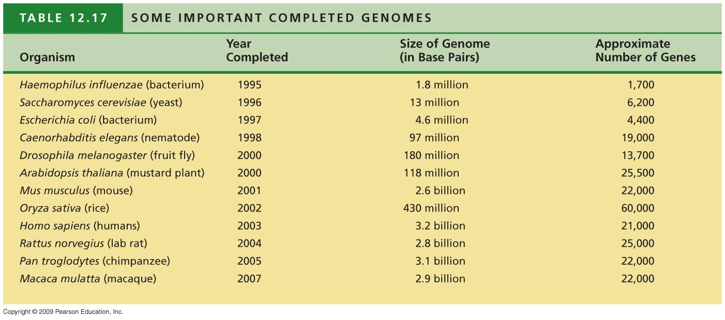
0
Notes:
Table 12.17 Some Important Completed Genomes.
This table shows the surprising estimate of 21,000 genes for humans, only 2,000 more than predicted for the nematode Caenorhabditis elegans and 4,000 fewer than the estimate for a mustard plant. Humans may be able to make a greater number of proteins with a similar number of genes, through alternative splicing mechanisms, for example. While the precise number of different types of transcripts or proteins has not been determined for humans, estimates range from 47,000 to 100,000.

Slide 4
Genomes hold clues to evolution
0
Comparisons of human and chimp genomes
Differ by 1.2% in single-base substitutions
Differ by 2.7% in insertions and deletions of larger DNA sequences
Genes showing rapid evolution in humans
Genes for defense against malaria and tuberculosis
Gene regulating brain size
FOXP2 gene involved with speech and vocalization
Copyright © 2009 Pearson Education, Inc.
Notes:
Student Misconceptions and Concerns
1. The similarities in genotypes and phenotypes among members of a human family are expected and understood by most students. Yet many students have a difficult time extrapolating this knowledge and applying it to the phylogenetic relationships of other groups. The use of genomics to test phylogenetic relationships is an enormously powerful tool for modern systematics, and genomics provides significant support of the other types of evidence for evolution.
Teaching Tips
1. Students may enter your course with little appreciation of the scientific questions that remain unanswered. Struggling with the details of what we now know can overwhelm our students, leaving little room to wonder about what is not yet understood. The surprises and questions noted in Modules 12.18–12.21 reveal broad challenges that await the work of our next generation of scientists. Emphasize the many opportunities that exist to resolve unanswered questions, here and throughout your course, as an invitation to future work for students.

