Slide 1
Gene therapy
0
Gene therapy aims to treat a disease by supplying a functional allele
One possible procedure
Clone the functional allele and insert it in a virus vector
Use the virus to deliver the gene to an affected cell type from the patient, such as a bone marrow cell
Viral DNA and the functional allele will insert into the patient’s chromosome
Return the cells to the patient for growth and division
Examples
Copyright © 2009 Pearson Education, Inc.
Notes:
At the present time, gene therapy methods supply a functional allele but do not replace the defective one. Most currently used vectors promote random integration of a therapeutic allele into a chromosome, so the location may be far from the defective allele. The production of the functional gene product alleviates the disease symptoms.
Student Misconceptions and Concerns
1. The genetic engineering of organisms can be controversial, creating various degrees of social unease and resistance. Yet, many debates about scientific issues are confused by misinformation. This provides an opportunity for you to assign students to take a position on such issues and support their arguments with accurate research. Students might debate whether a food or drug made from GM/transgenic organisms should be labeled as such, or discuss the risks and advantages of producing GM organisms.
2. The fact that the technologies described in this chapter can be used to swap genes between prokaryotes and eukaryotes reveals the fundamental similarities in genetic mechanisms shared by all forms of life. This very strong evidence of common descent provides proof of evolution that may be missed by your students.
Teaching Tips
1. As gene therapy technology expands, our ability to modify the genome in human embryos through in vitro fertilization permits genetic modification at the earliest stages of life. Future generations of humans, like our crops today, may include those with and without a genetically modified ancestry. The benefits and challenges of these technologies raise issues many students have never considered. Our students, and the generations soon to follow, will face the potential of directed human evolution.

Slide 2
Gene therapy
0
Challenges
Safe delivery to the area of the body affected by the disease
Achieving a long-lasting therapeutic effect
Addressing ethical questions
Copyright © 2009 Pearson Education, Inc.
Notes:
In 1993, a gene therapy trial in the United States on three infants with SCID showed that the functional allele could be delivered to blood-forming umbilical cord stem cells and that those cells would repopulate the bone marrow when returned to the patient. Unfortunately, the stem cells did not generate a large enough population to completely alleviate the disease. In 2002, a group of Italian physicians achieved success with two SCID patients, treated at 7 and 30 months of age. Their approach was to reduce the population of bone marrow stem cells through chemical treatment prior to providing stem cells with the functional allele. The genetically corrected cells were able to substantially repopulate the bone marrow as a result. Both patients are healthy and growing and developing normally.
Student Misconceptions and Concerns
1. The genetic engineering of organisms can be controversial, creating various degrees of social unease and resistance. Yet, many debates about scientific issues are confused by misinformation. This provides an opportunity for you to assign students to take a position on such issues and support their arguments with accurate research. Students might debate whether a food or drug made from GM/transgenic organisms should be labeled as such, or discuss the risks and advantages of producing GM organisms.
2. The fact that the technologies described in this chapter can be used to swap genes between prokaryotes and eukaryotes reveals the fundamental similarities in genetic mechanisms shared by all forms of life. This very strong evidence of common descent provides proof of evolution that may be missed by your students.
Teaching Tips
1. As gene therapy technology expands, our ability to modify the genome in human embryos through in vitro fertilization permits genetic modification at the earliest stages of life. Future generations of humans, like our crops today, may include those with and without a genetically modified ancestry. The benefits and challenges of these technologies raise issues many students have never considered. Our students, and the generations soon to follow, will face the potential of directed human evolution.

Slide 3
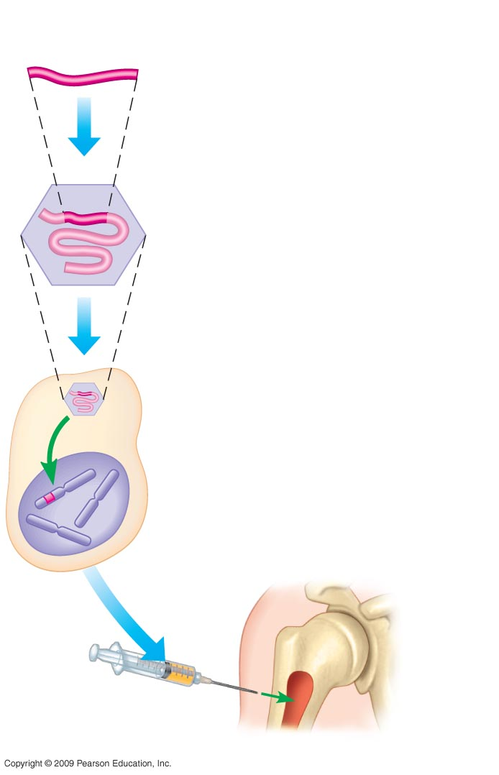
Cloned gene
(normal allele)
0
1
Insert normal gene
into virus
Viral nucleic acid
Retrovirus
2
Infect bone marrow
cell with virus
3
Viral DNA inserts
into chromosome
Bone marrow
cell from patient
Bone
marrow
4
Inject cells
into patient
Notes:
Figure 12.10 One type of gene therapy procedure.

Slide 4
DNA PROFILING
Copyright © 2009 Pearson Education, Inc.

Slide 5
DNA Profiling
0
DNA profiling is the analysis of DNA fragments to determine whether they come from a particular individual
Compares genetic markers from noncoding regions that show variation between individuals
Involves amplification (copying) of markers for analysis
Sizes of amplified fragments are compared
Copyright © 2009 Pearson Education, Inc.
Notes:
For BLAST Animation DNA Fingerprinting, go to Animation and Video Files.
Student Misconceptions and Concerns
1. Television programs might lead some students to expect DNA profiling to be quick and easy. Ask students to consider why DNA profiling actually takes many days or weeks to complete.
Teaching Tips
1. Figure 12.11 describes the general steps of DNA profiling. This overview is a useful reference to employ while the details of each step are discussed.

Slide 6
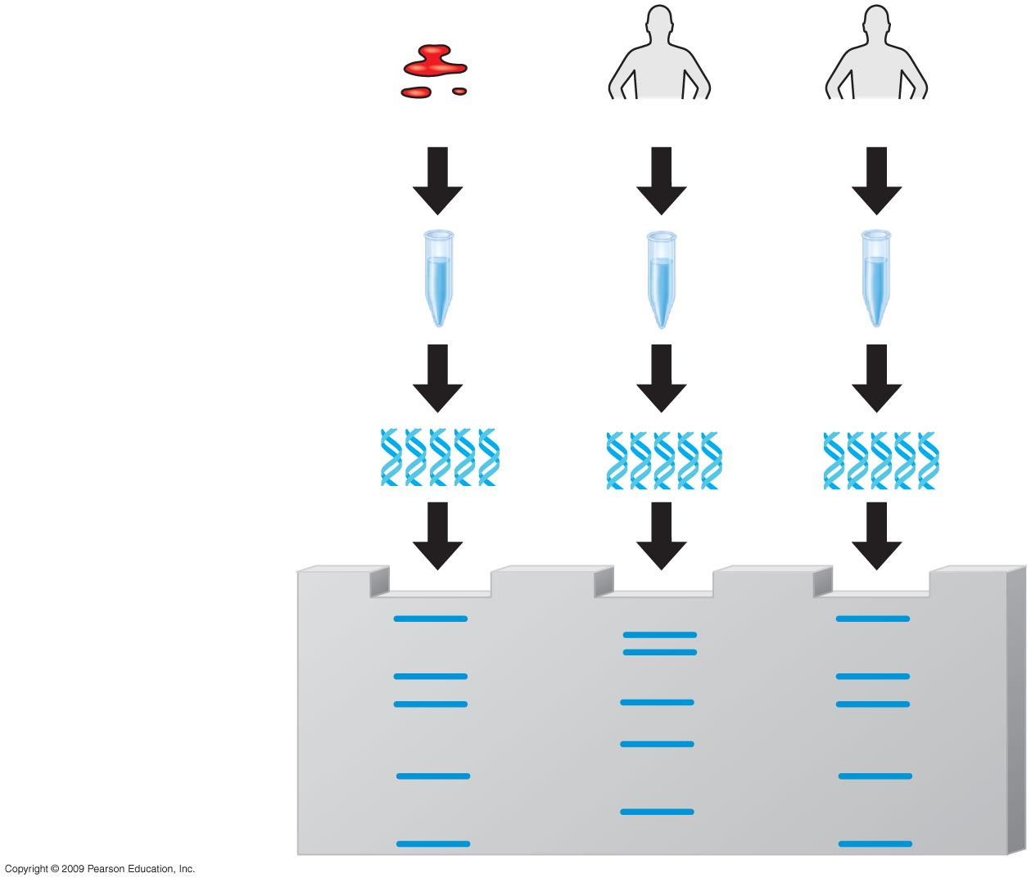
0
Crime scene
Suspect 1
Suspect 2
1
DNA isolated
2
DNA of selected
markers amplified
3
Amplified DNA
compared
Notes:
Figure 12.11 An overview of DNA fingerprinting.
This figure shows the process of DNA profiling (also called DNA fingerprinting).
DNA is isolated.
DNA is amplified by polymerase chain reaction (see Module 12.12).
The amplified fragments are compared by agarose gel electrophoresis (see Module 12.13).

